Slide 1
State of the Science
Dr. Alexis Topjian

Slide 2
Objectives
Review TTM literature
Adult
Neonatal
Pediatric

Slide 3
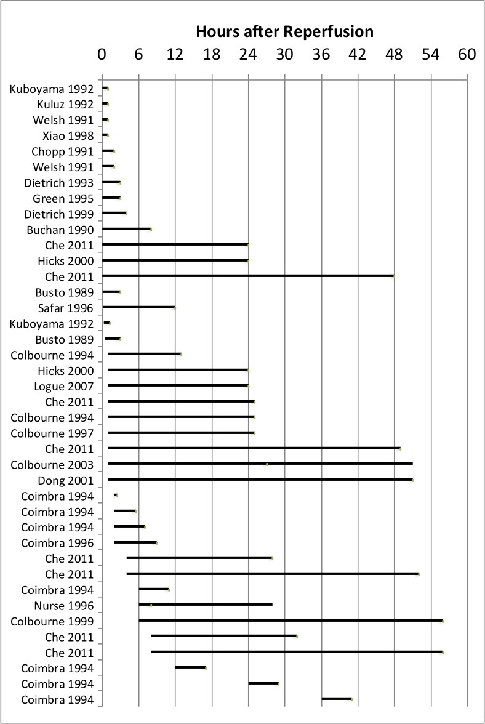
Animal studies of mild-moderate hypothermia (32-34ºC).
Immediate, brief hypothermia has benefit
Benefit of brief hypothermia not long-lasting
Longer duration has lasting benefit
Any delay negates benefit of brief hypothermia
Longer duration has benefit after delay
Brief delay negates benefit of brief or 3-hour hypothermia
Longer (>5 hr) duration has benefit after 6-8 hour delay
No duration has benefit after 8-12 hour delay

Slide 4
Ischemia
Injury
Minutes
Hour
Hours

Slide 5
Ischemia
Injury
Reperfusion
Minutes
Hour
Hours

Slide 6
Ischemia
Injury
Reperfusion
Secondary / Delayed Injury
Minutes
Hour
Hours
Days

Slide 7
Cold during CPR or within minutes of ROSC
Ischemia
Injury
Reperfusion
Secondary / Delayed Injury
Minutes
Hour
Hours
Days

Slide 8
Cold during CPR or within minutes of ROSC
Ischemia
Injury
Cold started > 30 min after ROSC
Reperfusion
Secondary / Delayed Injury
Minutes
Hour
Hours
Days

Slide 9
Why Hypothermia?

Slide 10
Does Hypothermia Work in Humans?
Which Ones?
Neonates
Children
Adults

Slide 11
The Road to Pediatric TTM
TTM2
2021
THAPCA-IH
2019
THAPCA-OH
2017
2015
HYPERION
Gluckman Cool Cap
Shankaran
TTM
2013
2005
Bernard
HACA
2002

Slide 12
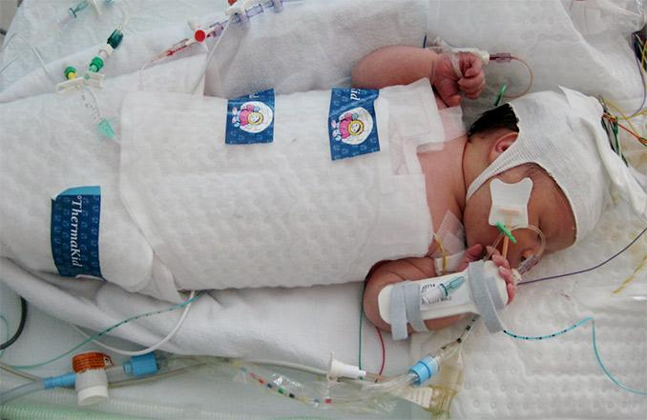

Slide 13
Cochrane Hypothermia for Perinatal Asphyxia
11 randomised controlled trials 105 term and late preterm infants with moderate/ severe encephalopathy and evidence of intrapartum asphyxia.
Therapeutic hypothermia resulted in a statistically significant and clinically important reduction in
mortality or major neurodevelopmental disability to 18 months of age (typical RR 0.75 (95% CI 0.68 to 0.83)
mortality (typical RR 0.75 (95% CI 0.64 to 0.88),
neurodevelopmental disability (typical RR 0.77 (95% CI 0.63 to 0.94)
Some adverse effects of hypothermia included an increase sinus bradycardia and a significant increase in thrombocytopenia.
Jacobs, Cochrane Review, 2013

Slide 14
Neonates: >8 RCTs
 | Intervention | Number
Azzopardi (2009) | 33-34ºC vs. 36.8-37.2 x 72 hrs | 325
Bharadwaj (2012) | 33-34ºC vs. 36.5ºC x 72 hrs | 130
Gane (2013) | 33-34ºC vs. 36.5ºC x 72 hrs | 122
Jacobs (2011) | 33-34ºC vs. 36.8ºC x 72 hrs | 221
Joy (2013) | 33-34ºC vs. 36.5ºC x 72 hrs | 160
Li (2009) | 33-34ºC vs. 36.5-37ºC x 72 hrs | 93
Shankaran (2005) | 34.5ºC vs. 36.5-37ºC x 72 hrs | 208
Simbruner (2010) | 33-34ºC vs. 36.5-37.5ºC x 72 hrs | 129
Quality of Evidence: High
Total number of term neonates in trials: 1388
Ongoing studies: combining treatments, selective head cooling

Slide 15
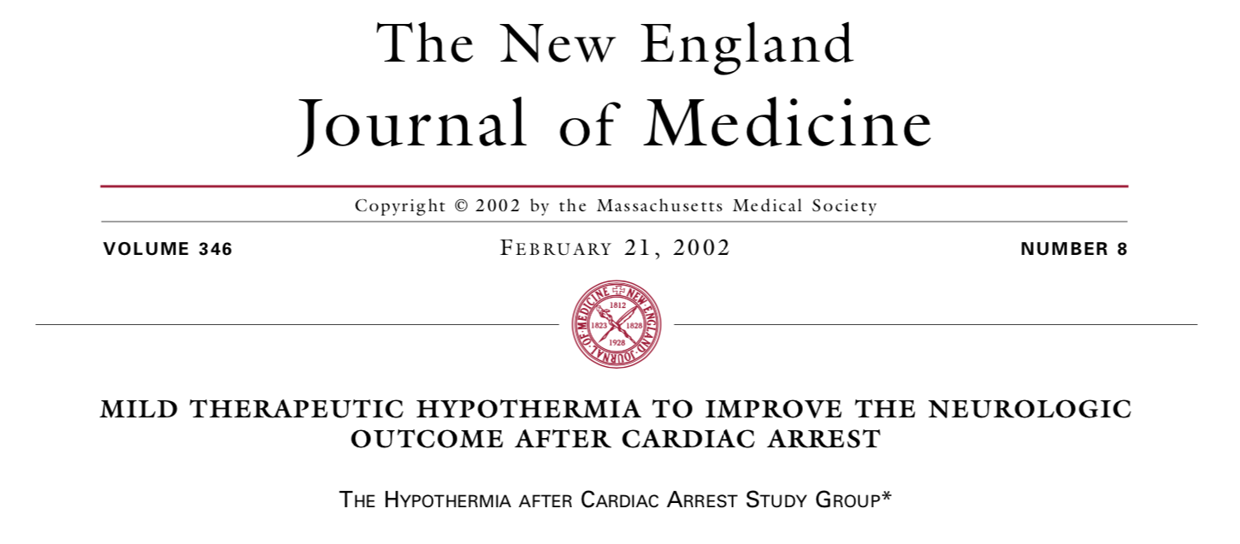
24 hrs x 32-34ºC vs. No temperature control
12 hrs x 33º vs. No temperature control

Slide 16
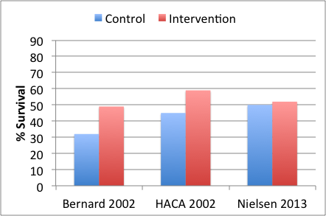
The Early Studies
Control of temperature at 33ºC or 32-34ºC results in more survival (49-59%) than no temperature control (32-45%).
59%
49%
45%
32%
N=77
N=275
Hypothermia after Cardiac Arrest Study Group 2002; NEJM 346: 549;
Bernard 2002; NEJM 346: 557

Slide 17
939 subjects
Shockable rhythms/witness non-shockable
Regimented post-arrest care and prognostication

Slide 18
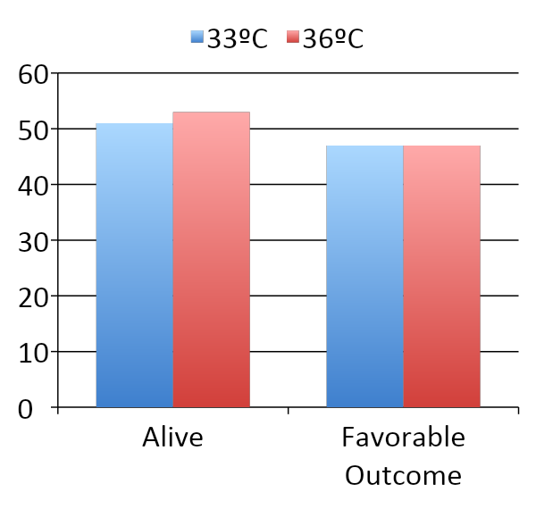
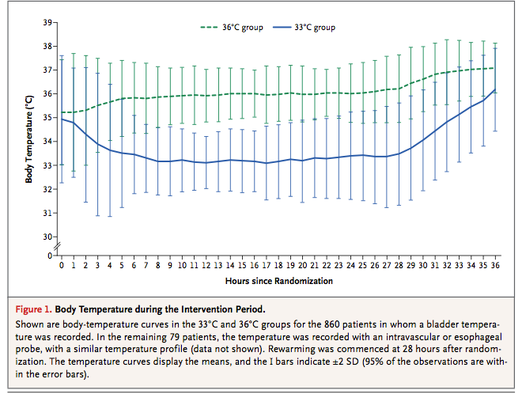
Nielsen 2013 - TTM Trial
This trial enrolled more patients than all prior trials combined (N=939)
Treatment was successfully delivered
No difference in primary or secondary outcomes
50%
52%
48%
48%
% of Subjects
180 days

Slide 19
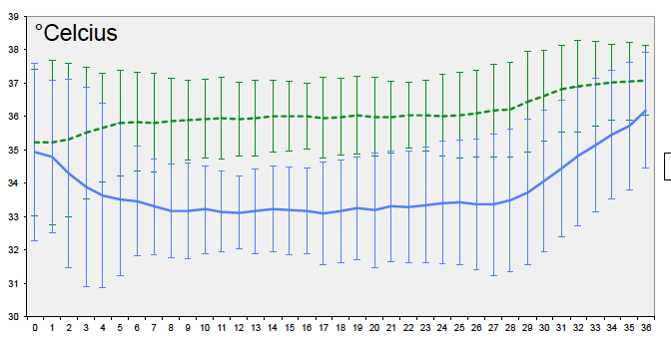
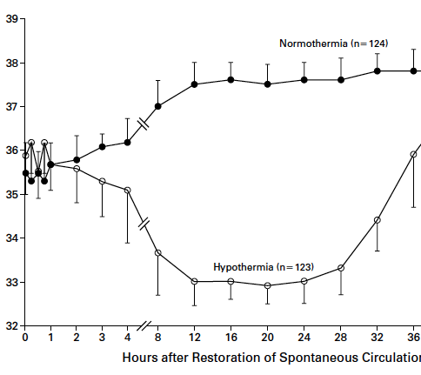
Marked differences in “control” group
Nielsen et al HACA study
~37.6ºC
~36.0ºC
Bernard et al: ~37.3ºC
Large difference in maintenance temperatures

Slide 20
The Early adult studies.. Cooling outcomes

Slide 21
Hyperion Trial
33°C vs 37°C for 24 hours non-shockable rhythm
IHCA or OHCA, GCS 8
Excluded no flow > 10 min, CPR > 60 min
CPC at 90 days
Approximately 284 in each treatment arm
Lasacarrou 2019
Notes:
Excluded if no flow of 10 minutes, CPR > 60 min, epi > 1
Rewarmed 0.25 to 0.5 every hours to 36.5 to 37.5 with your own device

Slide 22
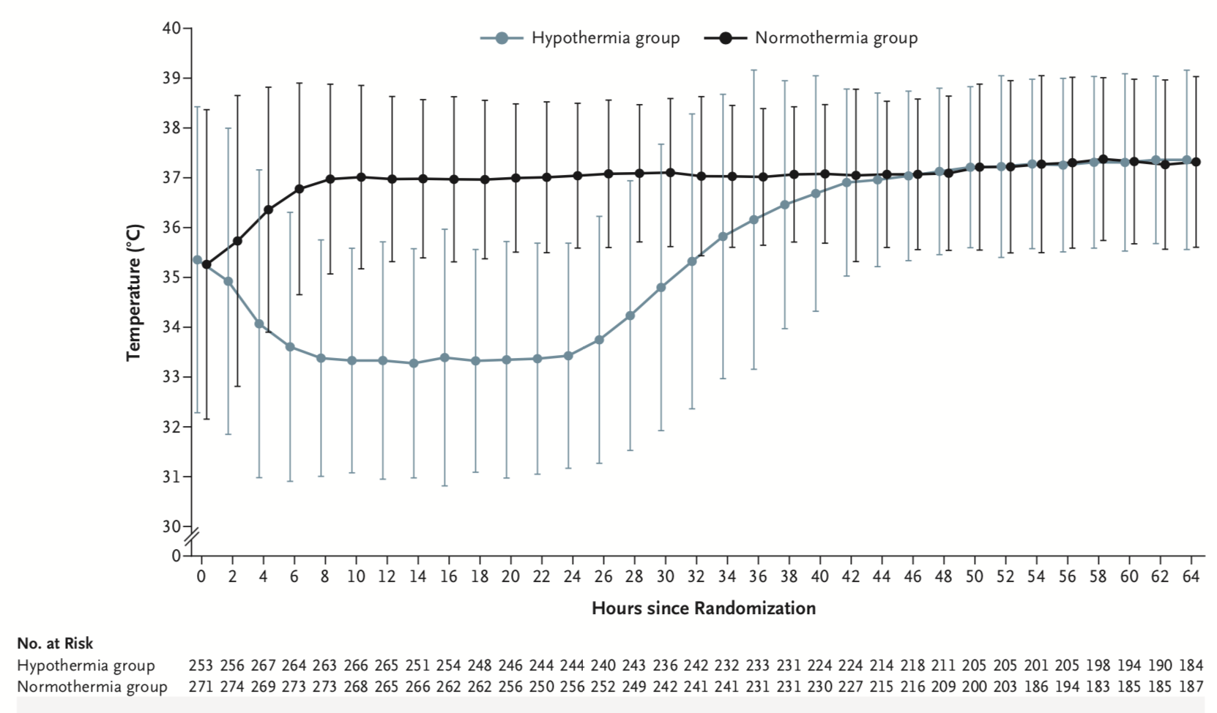
HYPERION Trial

Slide 23
HYPERION - Outcomes
Improved neurologic outcome
No difference in mortality
No difference in adverse events
5.7 %
P=0.04
10.2 %

Slide 24
2021

Slide 25
Population
Inclusion
Age ≥ 18 years
OHCA of presumed cardiac cause
Sustained ROSC >20 min.
Unconscious
Defined by the FOUR score motor response <4
Not able to obey verbal command
No limitations in care
< 3 hours after ROSC
Exclusion
Unwitnessed cardiac arrest with initial rhythm asystole
Temperature on admission <30°C
On ECMO prior to ROSC
Suspected pregnancy
Intracranial bleed
Severe COPD long-term O2

Slide 26
After randomization
40 h
Sedation
Ventilation
Hypothermia 33°C
Normothermia with early treatment of fever < 37.8°C
72 h of fever treatment
96 h to neuroprognostication
Full organ support until discharge or WLST
Outcomes
Primary: death at 6 months
Secondary: modified Rankin at 6 months

Slide 27
Notes:
EQ-VAS mean score 74% vs 75%

Slide 28
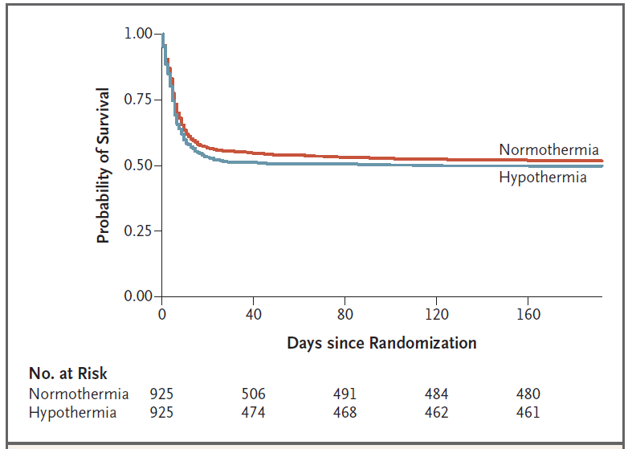
Hazard ratio for death in the hypothermia group
1.08 (0.05-1.23)
Notes:
Looking at survival ratio as time to event, the hazard ratio for death in the hypothermia group was 1.08. We can see that the curves decline between the first 30 days, but after the initial decline mortality is fairly stable

Slide 29
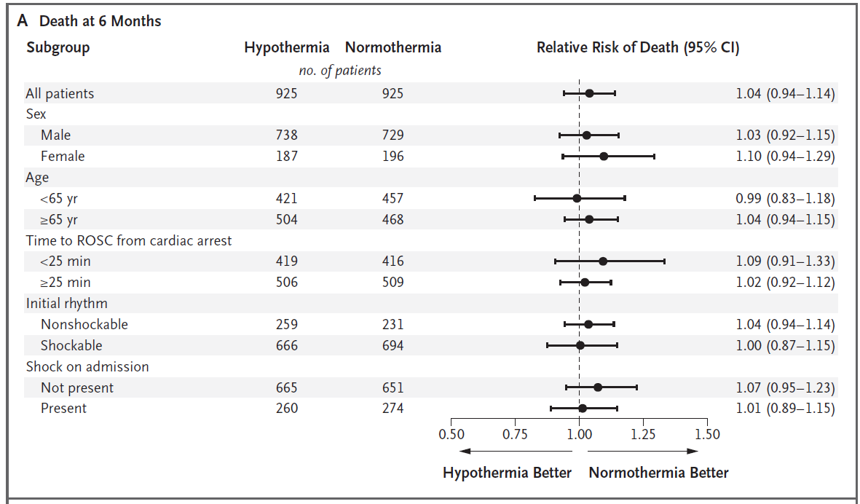
No mortality beneficial effect of hypothermia in any of the pre-specified subgroups

Slide 30
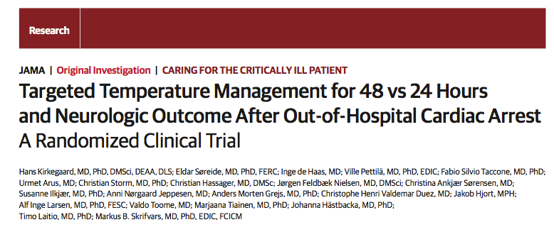
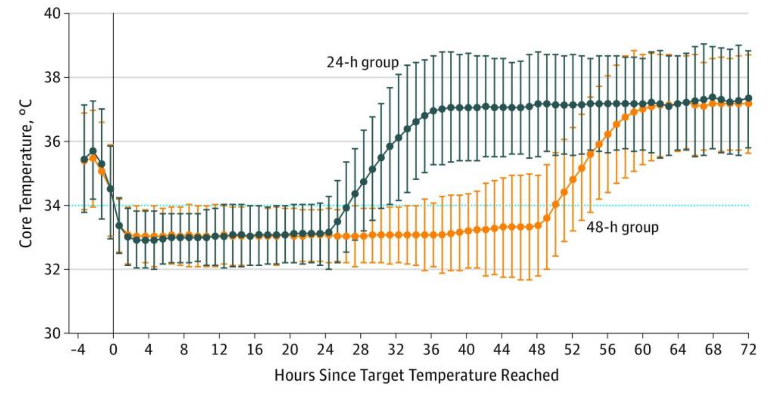
N=354

Slide 31
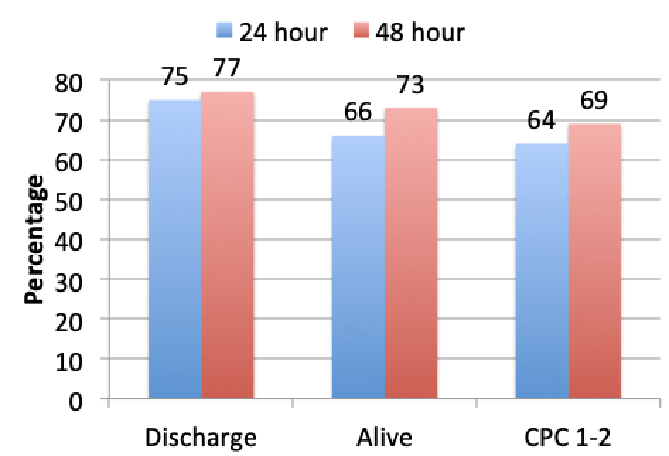
TTM for 48 vs. 24 Hours
N=354
Kirkegaard 2017 JAMA 318: 341–350

Slide 32
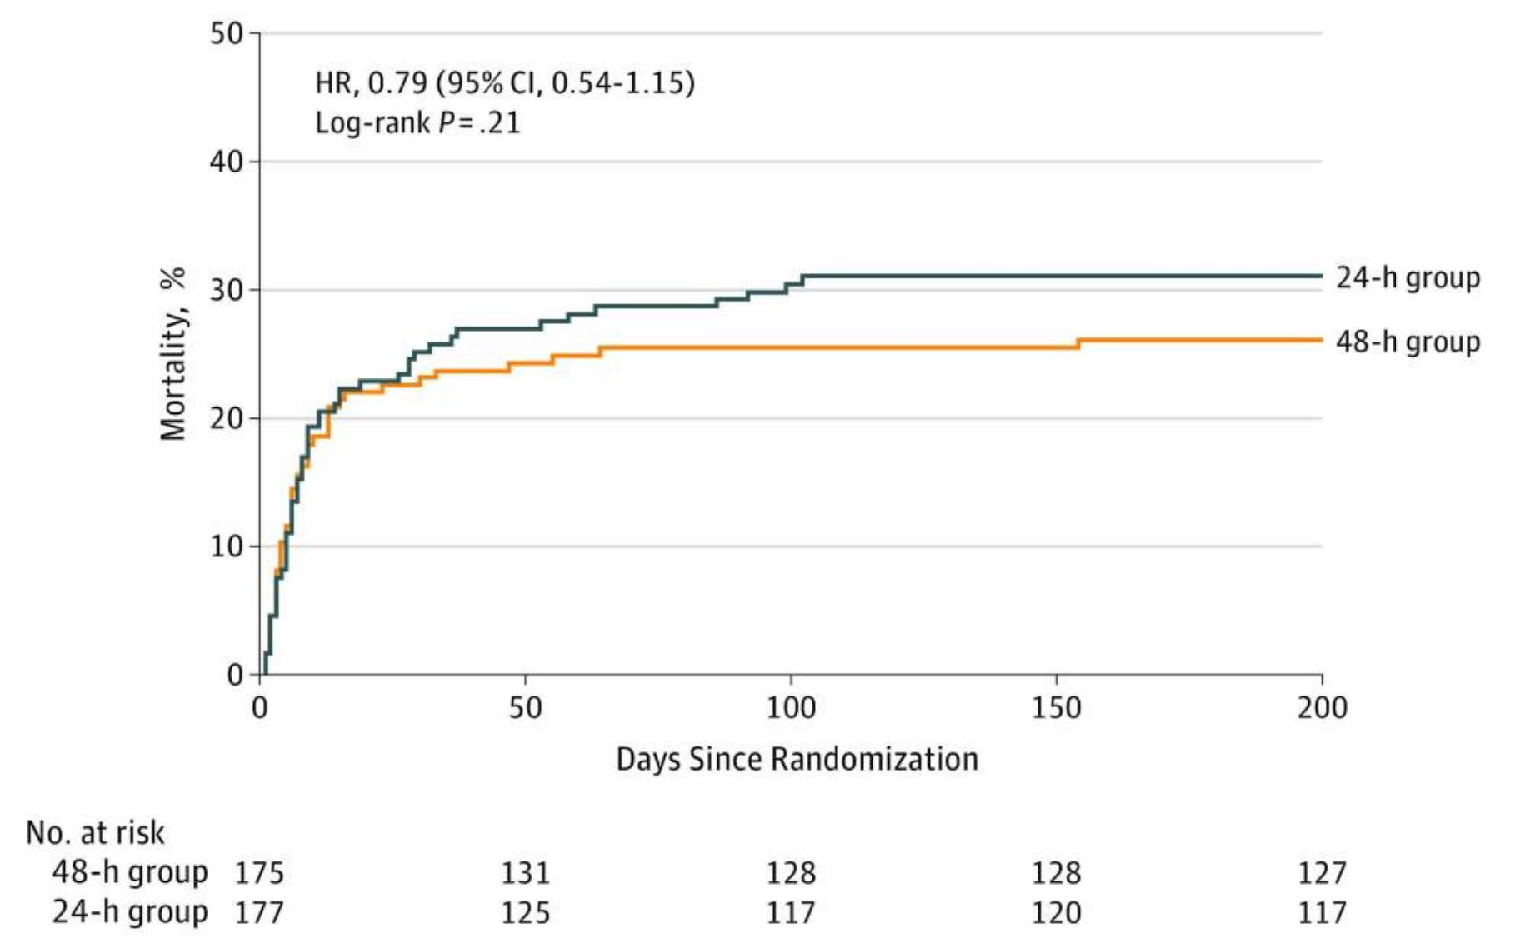
TTM for 48 vs. 24 Hours
Mortality, %
Kirkegaard 2017 JAMA 318: 341–350

Slide 33
The Road to Pediatric TTM…
THAPCA-IH
THAPCA-OH
2017
2015
Gluckman Cool Cap
Shankaran
TTM1
2013
2005
Bernard
HACA
2002

Slide 34
Enrolled 2009 - 2012
Enrolled 2009 - 2015
Moler NEJM 2015
Moler NEJM 2017
Notes:
34
34
IHCA enrollment on going
Target enrollment 450-600
Current enrollment approximately 240

Slide 35
THAPCA Trials: IHCA and OHCA
2 days to 18 years old
Motor GCS < 5
CPR > 2 minutes
Randomized within 6 h of ROC
Intervention
33°C or 36.8 °C for 48 h
Normothermia through 120h
Primary Outcome
VABS > 70 at 1 year
Moler, NEJM, 2015, 2017

Slide 36
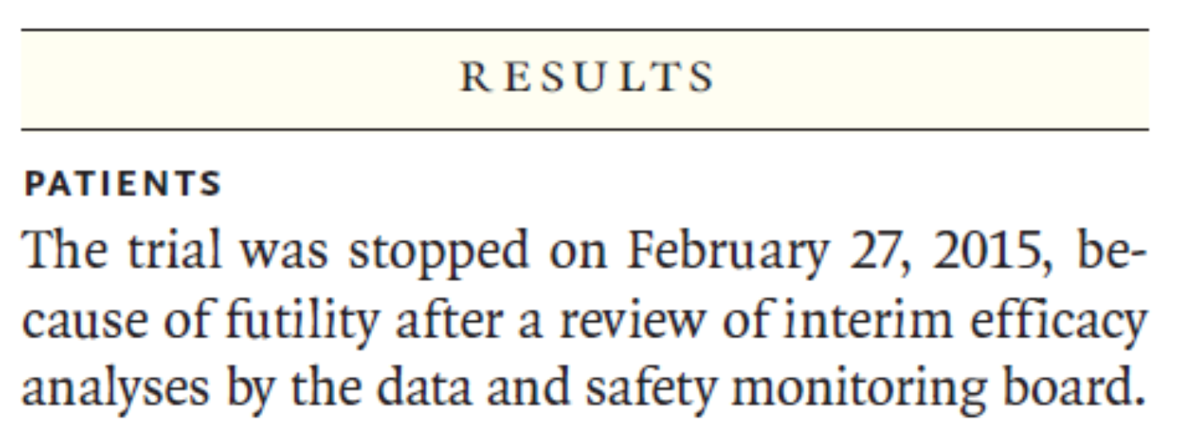
THAPCA: In Hospital Cardiac Arrest
N = 329
Stopped for Futility
Moler NEJM 2017

Slide 37
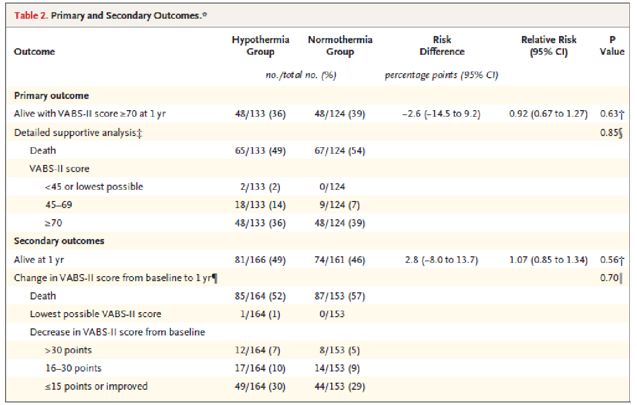
Results

Slide 38
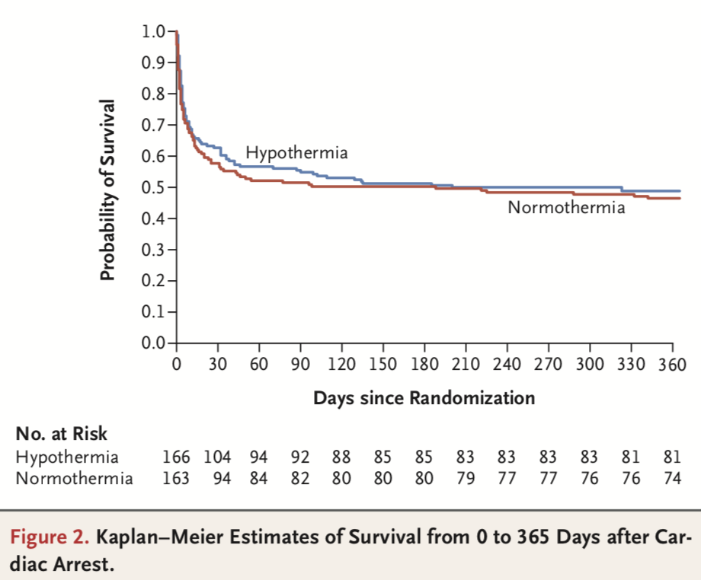
THAPCA- IHCA
49% vs. 46%

Slide 39
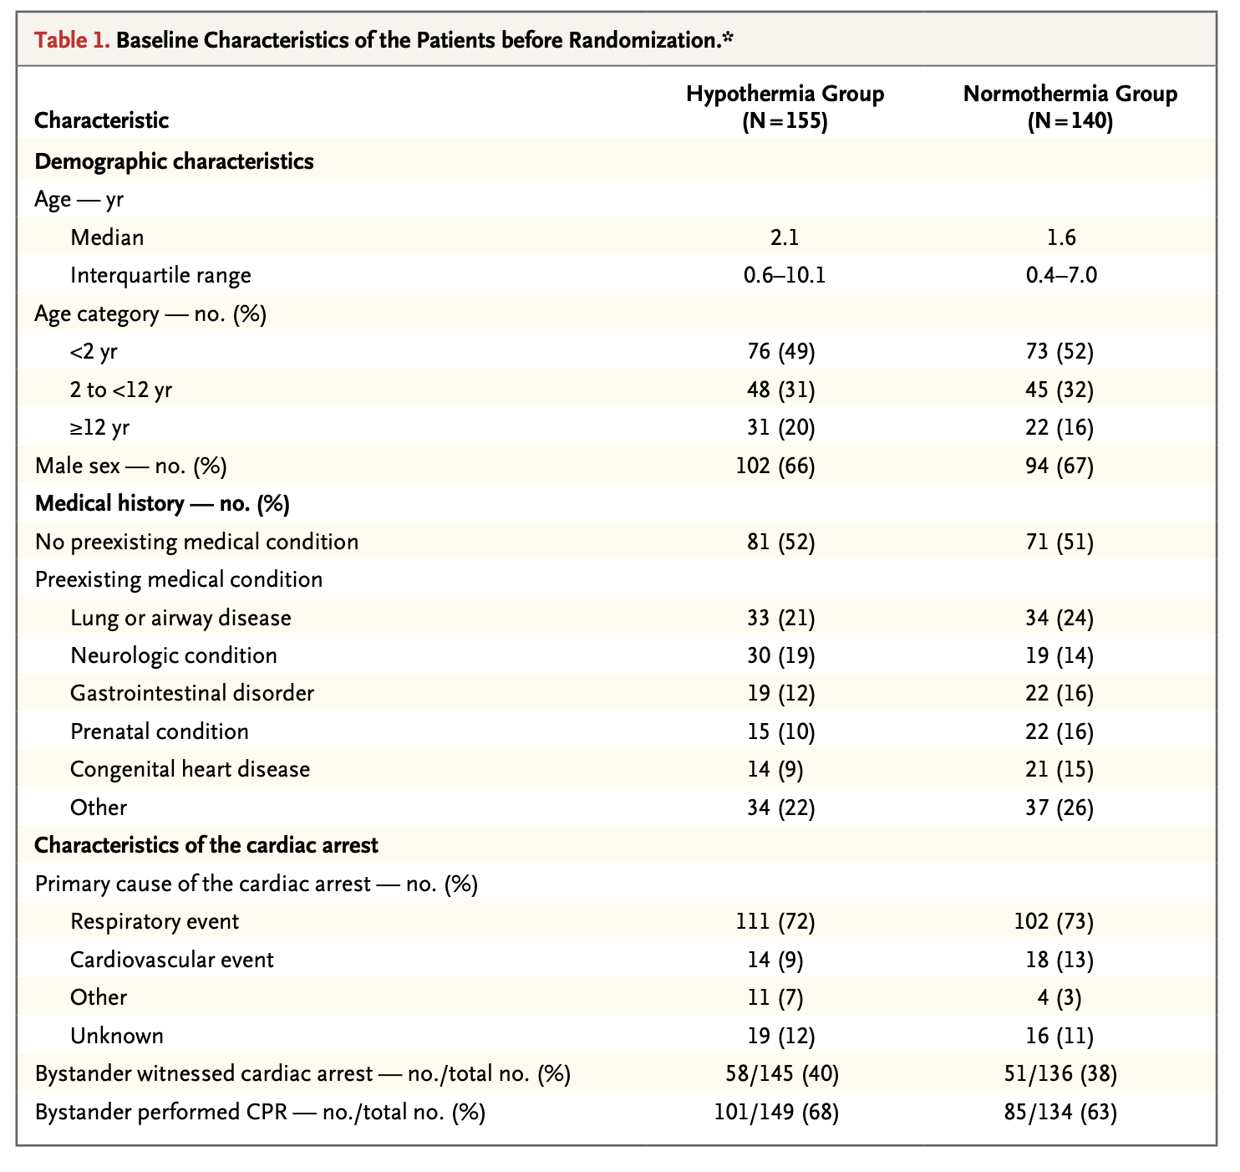
THAPCA- OHCA

Slide 40
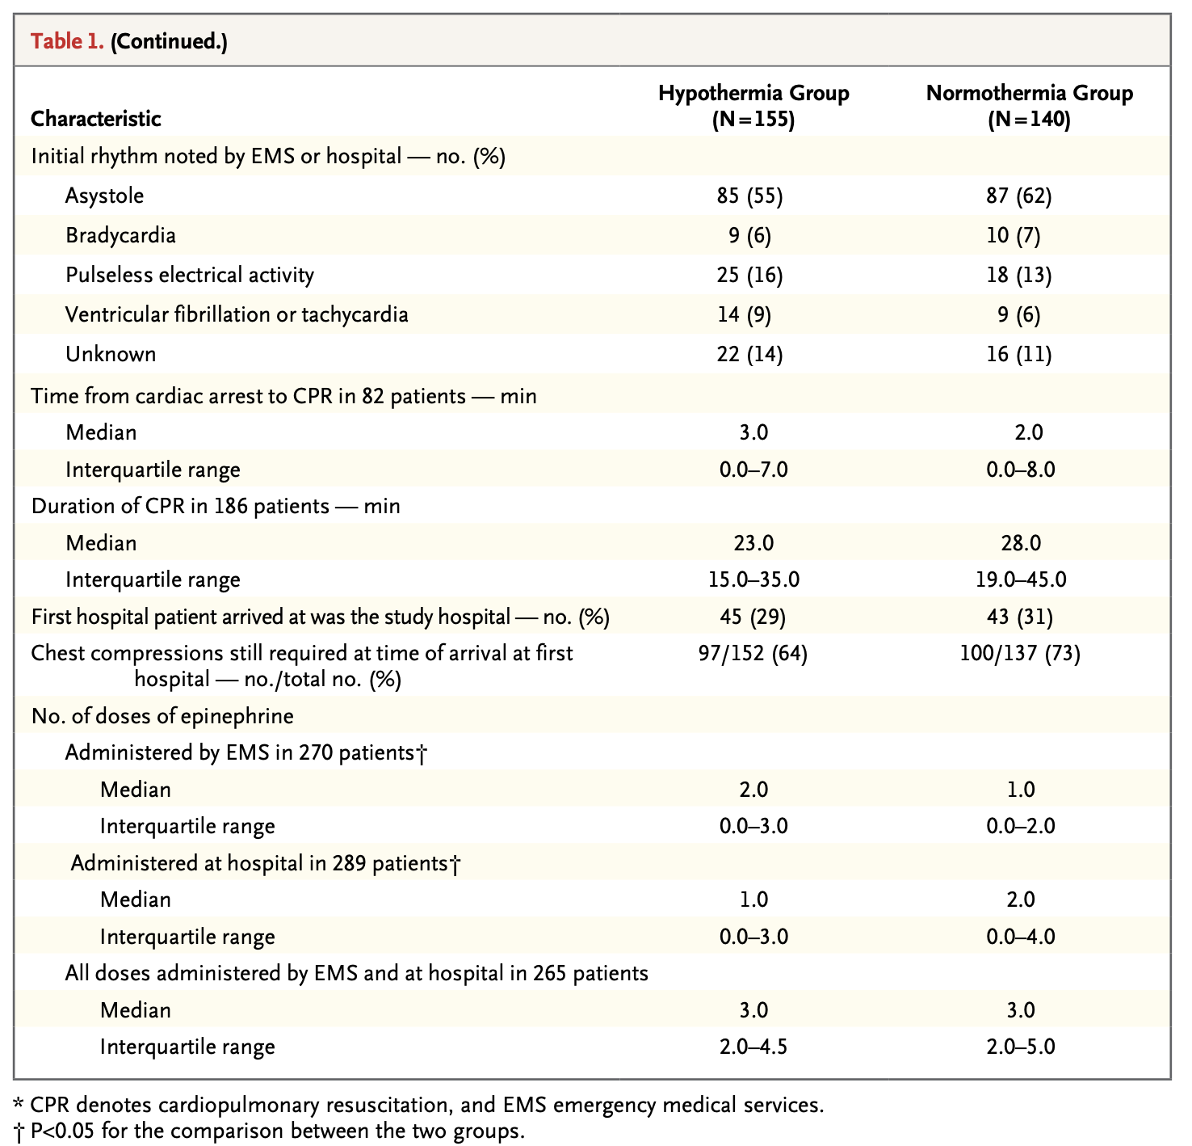
THAPCA- OHCA

Slide 41
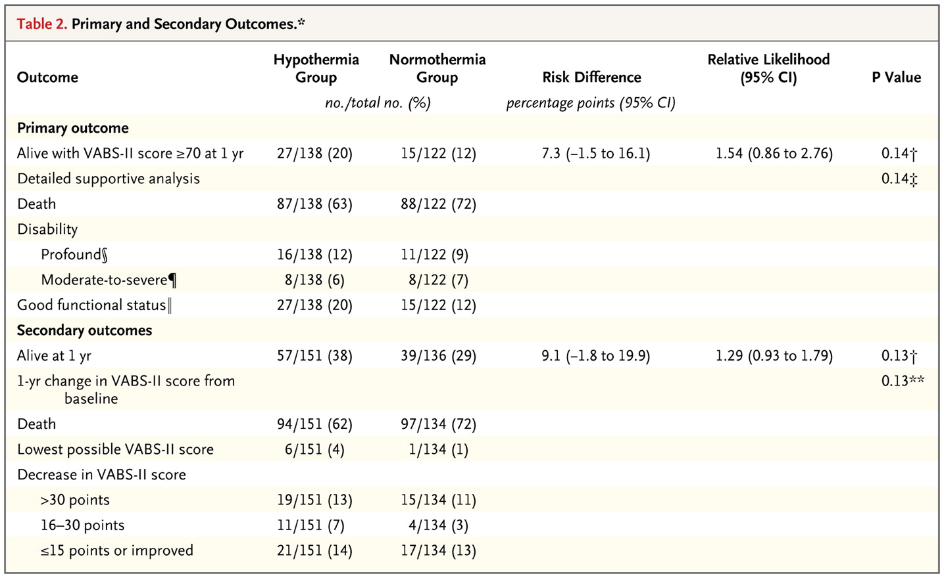
THAPCA: Out Of Hospital Cardiac Arrest

Slide 42
THAPCA: OHCA- Did it work?
Favorable Neuro (VABS >70) at 1 year (n=260)_
Normothermia: 12%
Hypothermia: 20%
Likelihood Ratio 1.54 (0.9-2.8), p=0.14
36.8°C
33°C
No statistically significant
difference in outcomes

Slide 43
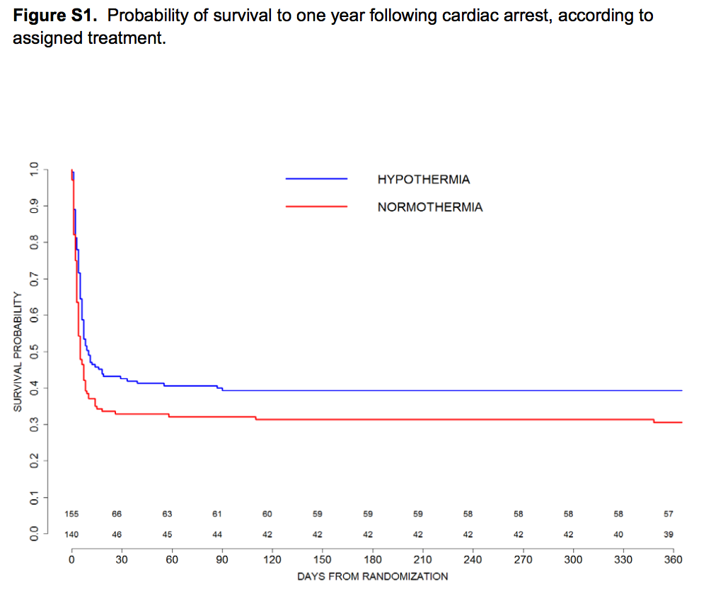
THAPCA: OHCA- Survival Over Time
Significant Difference
Log-rank test, p=0.04
^{Moler FW, N Engl J Med 2015.}

Slide 45
THAPCA OHCA Safety

Slide 46
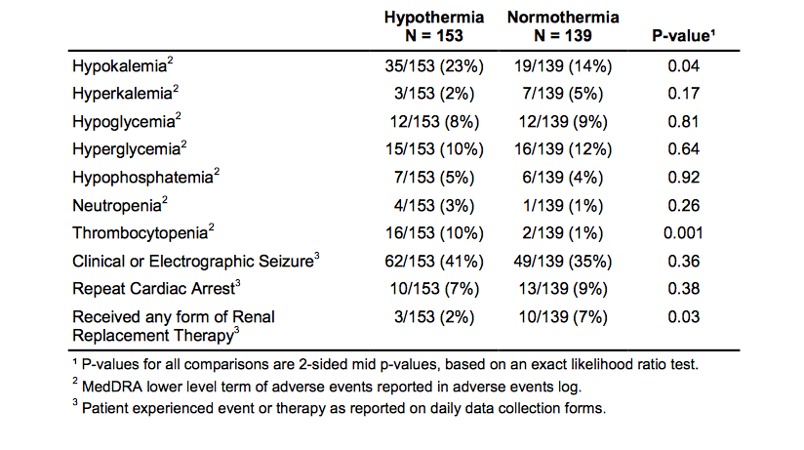
THAPCA OHCA Safety

Slide 47
THAPCA IHCA Safety

Slide 48
THAPCA IHCA Safety

Slide 49
THAPCA OHCA: Limitations
Selection Criteria
Coma and motor GCS <5
No stratification of injury severity
Underpowered
85% Power to detect a
20% improvement in 1 year Neurologic Outcome
Intervention
Was 48 hours the right duration

Slide 50
Resuscitation 2018
Pooled analysis of THAPCA-OH and THAPCA-IH
N=624

Slide 51
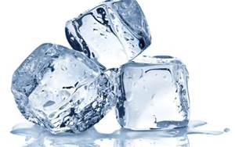
2019: International Liaison Committee on Resuscitation
For infants and children with OHCA, TTM be used to target a central temp < 37.5° C
Inconclusive evidence to support or refute the use of TTM 32°C to 34°C compared to TTM 36°C to 37.5 °C
The task force preferred the used of TTM 32°C to 34°C as opposed to TTM 36°C to 37.5 °C
Soar et al., Circulation, 2019
Notes:
Continuous measurement of core tempera-
ture during TTM is recommended (Class 1;

Slide 52
AHA PALS Guidelines 2019: Temperature
For infants and children < 18 years of age who are comatose after IHCA or OHCA it is reasonable
5 days of normothermia (36°C to 37.5°C)
OR
2 days of hypothermia (32°C to 34°C)
followed by 3 days of continuous normothermia
There is insufficient evidence to support a recommendation regarding treatment duration
Duff et al., Circulation, 2019, Topjian Circulation 2020
Notes:
Continuous measurement of core tempera-
ture during TTM is recommended (Class 1;

Slide 53
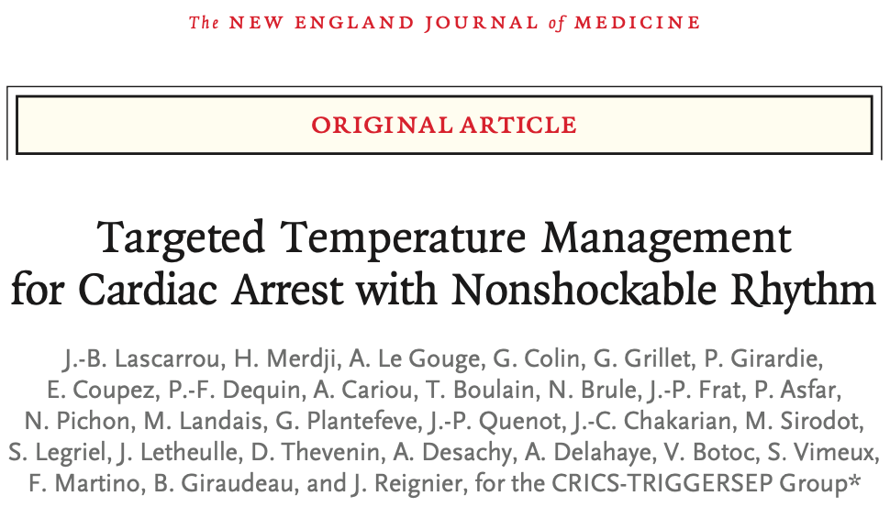
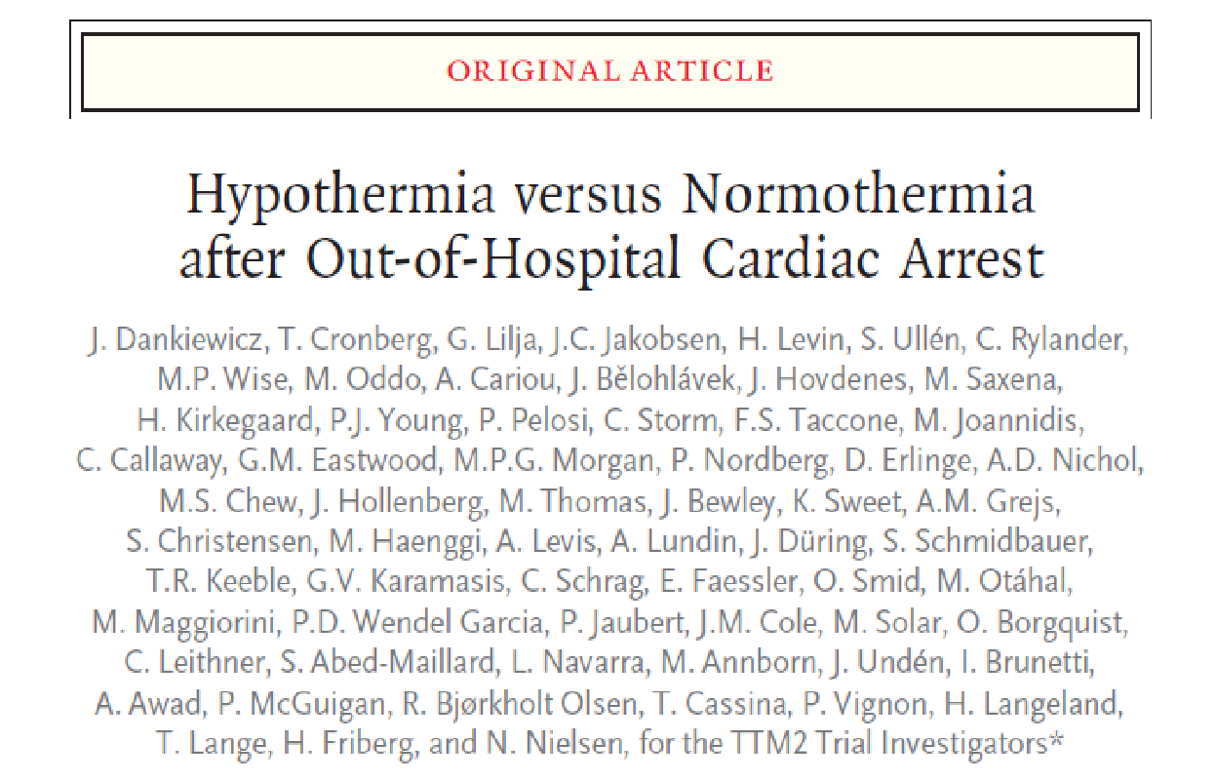
Hyperion
A bit more like kids
TTM2
Not so much like kids
Lascarrou JB, et al. NEJM 2019
Notes:
IHCA or OHCA, GCS 8
Excluded no flow > 10 min, CPR > 60 min
CPC at 90 days
Approximately 284 in each treatment arm
- GCS < 8

Slide 54
How do we compare to adults?
Characteristic | Hyperion | THAPCA-OH | TTM2
Age (years) | 67 | 2 | 64
Male | 64% | 66% | 80%
Witnessed | 93% | 39% | 91%
Bystander CPR | 70% | 65% | 80%
First Doc rhythm Shockable Non-shockable | 0% 90% | 7% 85% | 73% 24%
CPR duration (min) | 16 (10-26) | 26 (15-45) | 25 (16-40)
Cause of Arrest respiratory | 55% | 72% | n/a
Notes:
Hyperion
Gcs< 8
no flow < 10 min
Enollred within 5 hours
CPR > 60 min
IHCA or OHCA
90 days uputcome mrs

Slide 55
How do we put this all together?
OH

Slide 56
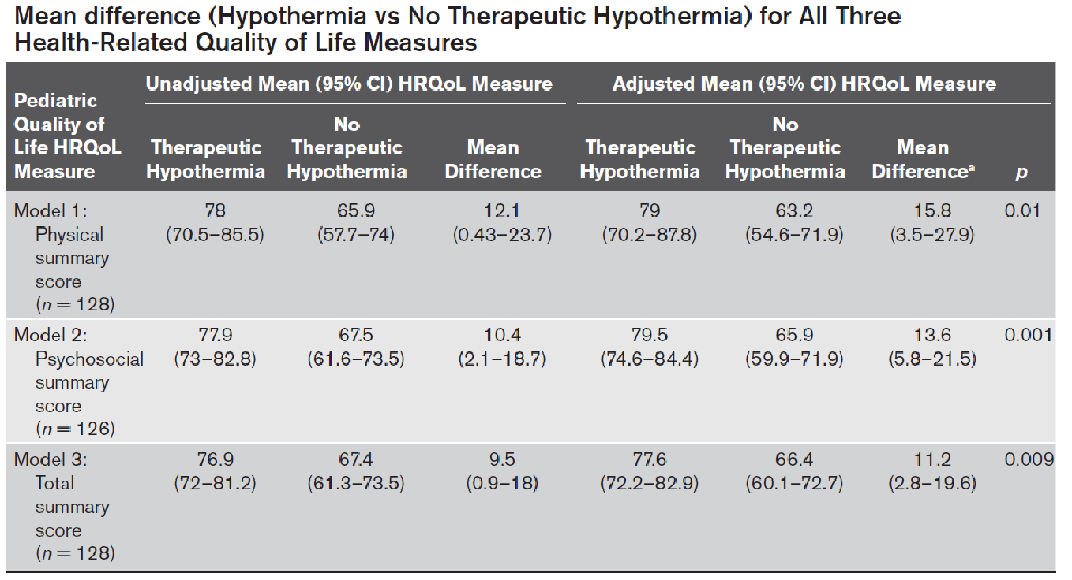
Playing the Long Game
Hypothermia vs No Hypothermia
Children 18 years old
IHCA or OHCA
CPR> 2 minutes
mechanically ventilated
2012 – 2017
50 (39%) therapeutic hypothermia
78 (61%) no therapeutic hypothermia
TH group sicker:
higher lactate
longer ventilation
more ECMO
longer CPR duration
Comparison to Normative Data
Physical
Summary
Psychosocial
Summary
Physical
Summary
PedsQL at median of 3.8 years
Psychosocial
Summary
No difference in discharge mortality
Total
Summary
Minimally Clinically Important Difference: physical 6.9 psychosocial 5.5
Magee PCCM 2021

Slide 57
Summary
TTM (32-36ºC) x 24 hrs in adults (2 RCT)
33ºC not superior to 36ºC for lightly injured (1 RCT)
33ºC is superior to 37ºC for more severe (1 RCT)
Very early hypothermia – mostly neutral (5 RCT)
TTM2 – results later this year (1 RCT)
Signal for 48 hrs better than 24 hrs (1 RCT)
Usual durations are 33ºC x 48 hrs in pediatrics
For pediatric OHCA favors 33ºC x 48 hrs (1 RCT)
For pediatric IHCA neutral for 33ºC x 48 hrs (1 RCT)
Usual durations are 33ºC x 72 hrs in neonates
For HIE in neonates, favors 33ºC x 72 hrs (8-10 RCT)

Slide 58
The Road to Pediatric TTM…
TTM2
2021
THAPCA-IH
2019
THAPCA-OH
2017
2015
HYPERION
Gluckman Cool Cap
Shankaran
TTM1
2013
2005
Bernard
HACA
2002

Slide 60
Questions and Discussion

