Slide 1
Protocol: Cooling Basics, Clinical Considerations, and Phases of Care
Dr. Frank Moler

Slide 2
Overview
This talk reviews basic temperature (temp) related information needed for P-ICECAP.
There is much information to know. Key content is repeated. (Sorry, no “Greatest Movies of All Time” trivia breaks as in THAPCA). Periodic review will be required during the trial.
The information presented will assist the research team in safe monitoring and application of cooling in our study subjects.
‘Just in time’ reviews with the clinical teams will be optimal, especially for the Induction of cooling and the Rewarming phases of P-ICECAP.

Slide 3
Outline
Definitions
Thermoregulation - basics
Physiologic and other clinical effects of hypothermia/cooling
Central temperature measurement
Factors impacting target temperature
Cooling protocol through 120 hours
Review/Checklist (extra)
Cases (extra)

Slide 4
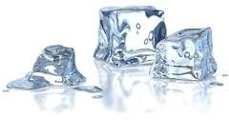
Definitions

Slide 5
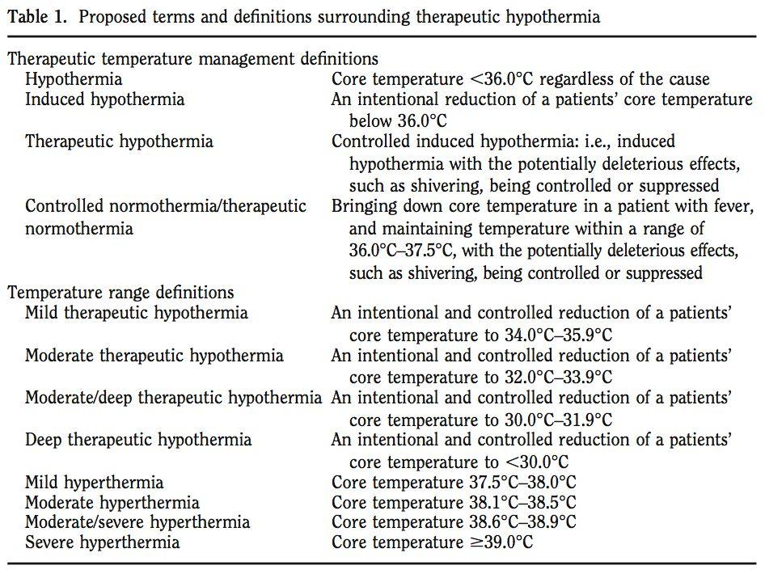
Polderman
CCM 2009

Slide 6
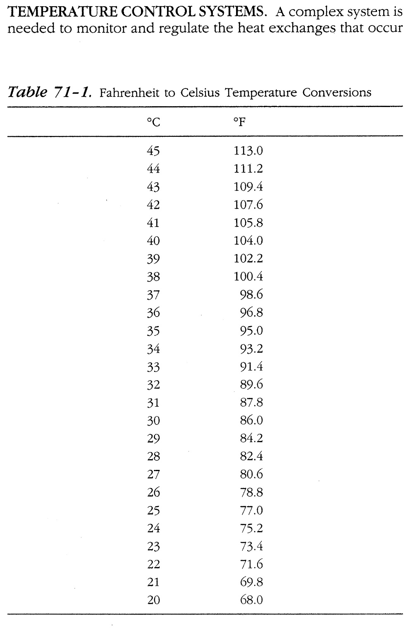
Therapeutic Normothermia
= Normothermia
TTM 36.0-37.5°C (36.8)
Therapeutic Hypothermia
= Cooling
TTM 32.0-34.0°C (33.0)
*Concern for arrhythmias at temp < 30°C. Rewarm STAT to goal
**Greatly increased risk of VF and other arrhythmias < 28°C. STAT rewarming required.
Irwin and Rippe. Intensive Care Medicine, 4th ed, 1999

Slide 7
Thermoregulation
Basics 101

Slide 8
Normal Thermoregulation
Heat production
Normal heat production from metabolic processes in liver, viscera, and muscle
During exercise or shivering, muscle primary source of heat generation, may be very large
Heat elimination
Radiation = heat from skin to object without contact (NA)
Convection = airflow across skin (minor P-ICECAP)
Conduction = skin to object in contact (#1 in P-ICECAP)
Evaporation = sweating (NA in P-ICECAP)

Slide 9
Normal Thermoregulation
Hypothalamus regulates body Tº
Afferent inputs to hypothalamus
Skin*, abdomen, thorax, spinal cord, brain
Hypothalamus processes based on its setpoint
Central temp below hypothalamic setpoint results in efferent responses
Cutaneous vasoconstriction
impedes heat transfer through skin
Shivering
generates heat (muscles)

Slide 10
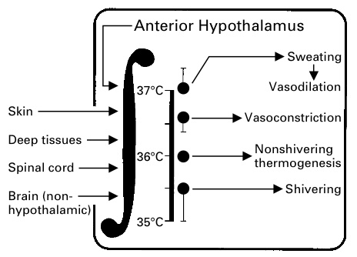
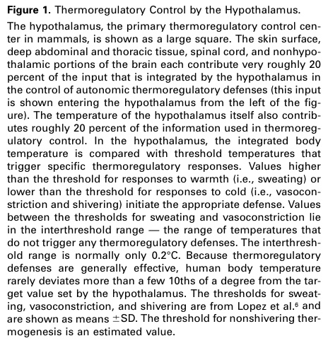
Sessler DI. NEJM 1997:336;1730-7

Slide 11
Thermoregulation
Pediatrics
Smaller infants / children
Larger SA/volume compared to adults
Reduced shivering response < 1 yr
Easier/shorter time to induce hypothermia (cooling) and temp control in very young
Shivering decreases at approximately 33.5ºC
P-ICECAP goal 33.0ºC in hypothermia (cooled) groups

Slide 12
Normal thermoregulation
Normothermia Phase
If hypothalamic set point is elevated (e.g., fever at 39ºC) relative to a goal temp 36.8ºC, one will see similar physiologic responses as Therapeutic Hypothermia (cooling) induction phase
Vasoconstriction
Shivering
Common etiologies of increased set point (fever)
Post-cardiac arrest syndrome
Infection
Normal temp range is ~36.5-37.5ºC during a day.
Cooling devices sensitive to approx. ± 0.2ºC from set point.
They will attempt to warm and cool normal subjects!

Slide 13
Physiologic and Other Effects of Cooling in P-ICECAP

Slide 14
List of Physiologic Effects
Shivering
Hypovolemia (during cooling and rewarming)
CV including bradycardia
Potassium
Glucose
Other chemistries (Mg, PO4, etc.)
LFTs, amylase/lipase, lactate
Plts/Coags
WBC/Inflammation/Infection
Drug metabolism
Metabolic rate
Blood gases
Skin
Modified from:
- Polderman, CCM 2009
- ILCOR, Circulation, 2008

Slide 15
1. Shivering
Frequent, causes heat generation and rewarming
Tx (REQUIRED)
Suggested agents
Opioids (e.g., fentanyl)
Benzodiazepines (e.g., midazolam) and others
NMB (e.g., vecuronium)
Shivering response decreases at ~ 33.5ºC
Shivering response less in young (< 1 yr)
Will see shivering in both hypothermia (cooled) and normothermia phases, if hypothalamic set point is greater than goal temperature
May or may not be visible

Slide 16
1. Shivering – drugs to inhibit
Benzodiazepines* (midazolam - example)
Sedative
Vasodilation (+/-)
Antiepileptic effects
Decrease shivering
Opiods* (fentanyl - example)
Analgesia, sedation
Vasodilation (+/-)
Decrease shivering
NMB* (vecuronium, rocuronium and others). Cis-Atracurium has temperature dependent metabolism, prolonged with cooling (Hofmann Reaction). Twitch monitoring with infusions.
Inhibits shivering, facilitates cooling and temperature control
Masks sedation level and seizures
*ILCOR, Circulation 2008 – drug classes recommended

Slide 17
Induction of Hypothermia without sedation
Polderman
CCM 2009
If hypothalamic set point normal at 37.0ºC
- Vasoconstriction - 36.5ºC
- Shivering - 35.5ºC
-↑HR
-↑Metabolic rate (40-100%)
-↑Stress response
Undesirable in patients with neurologic and/or post hypoxic injury
Increased risk of adverse cardiac events

Slide 18
Induction of Hypothermia with sedation/analgesia
Polderman
CCM 2009
↓Shivering
↓HR
↓ Metabolic rate
↓ Stress response
Improved neurologic outcome compared to no sedation/analgesia.
‘Proper sedation & analgesia are important for successful use of cooling’ (Polderman 2009).

Slide 19
2. CV: Hypovolemia
Hypovolemia – common during the cooling Induction Phase
often due to cold diuresis (renal);
results in tachycardia and hypotension;
requires tx
Note: if patient cooled and HR not reduced, may be sign of hypovolemia
Hypovolemia – also common during Rewarming Phase
Vasodilation; may result in tachycardia and hypotension; requires tx

Slide 20
3. CV effects
Cardiovascular (assuming pt deeply sedated and euvolemic)
- ↑ BP (MAP), ↑ CVP, ↑ M_{V}02
- ↓ HR
- ↓ CO (due to HR), but improved O₂ supply/demand ratio
Case series – cooling used for low cardiac output states (LCOS)
Used for JET post op ped cardiac patients

Slide 21
3. CV effects
ECG changes –
Bradycardia (🡻HR) common (🡹PR, 🡹 QRS,🡹QT intervals)
No specific tx usually required for 🡻HR, if temp >30ºC and otherwise stable
Atropine ineffective
If hypothermic without 🡻HR, consider hypovolemia or inadequate sedation as cause
Other arrhythmias uncommon if temp > 30ºC!
Arrhythmias at temps < 30ºC
28-30 ºC - 🡹 (AF & VF)
< 28 ºC - 🡹🡹VF.
STAT rewarming required if <30ºC (MANUAL Mode required for Blanketrol-III)

Slide 22
4. Electrolytes (Potassium = K+)
Close monitoring of K⁺ required post arrest due to AKI risk
Electrolytes q 6 hr during cooling and rewarming phases and q 12 hr during other phases
Induction Phase - serum K⁺ decreases
Careful replacement as needed
Rewarming Phase - serum K⁺ increases
Slow rewarming results in less elevation in K⁺
If patient received insulin for hyperglycemia and extra K⁺ replacement given, this may result in greater ↑ K⁺ on rewarming – be careful
Consider removing K⁺ from IV fluids during rewarming; supplement prn only if needed

Slide 23
5. Hyperglycemia (GLU)
Common post arrest due to stress response
Relative insulin resistance with cooling
Significance & optimal range for GLU unknown
Neonatal, adult and THAPCA RCTs did not use tight control
Often improves without tx in first 24 hr
Important: if insulin for hyperglycemia used during cooling, will need more K⁺ replacement. This may lead to HYPERkalemia and HYPOglycemia on rewarming as insulin resistance resolves.
Protocol suggests <200 mg/dl (range 80-200) acceptable
consider reducing glucose in IV solutions, insulin only as needed for GLU > 200.
Monitor q 6-12 hr. More often if insulin used.

Slide 24
6. Chemistries (other)
↓ Phosphate, Magnesium, Calcium
Each may decrease during cooling
Monitored at least daily
Replace if indicated
7. LFTs, Amylase/Lipase, Lactate
↑ Amylase, lipase, liver enzymes
↑ Lactate (up to 6 mmol/L)
Monitor at least daily
No tx generally required
Elevations also commonly associated with cardiac arrest

Slide 25
8. Hematology/Coagulation
Platelets
Mildly reduced numbers common
May require tx [platelet transfusion] if level too low for clinical setting (e.g., chest tube bleeding).
Mild abnormalities coagulation studies ~ 33ºC
NOT seen when measured in lab (37ºC)
Usually requires no tx [FFP transfusion]
Clinical trials including THAPCA-IH did not describe increased bleeding with cooling.
Monitor at least daily

Slide 26
9. Hematologic (Neutropenia)/Infection
↓ WBC (neutropenia) may occur
Impaired inflammatory response with cooling
Potentially higher risk of infection
Out of hospital cardiac arrests commonly associated with VAP and/or BSI in adults
THAPCA overall positive cultures 39-46% (lung, blood and urine). Drowning subgroup 43-67%
IMPORTANT:
Consider antibiotic prophylaxis in BOTH cooled & normothermia groups as fever will be masked in both.

Slide 27
10. Drug Metabolism
Drug clearance often dependent on enzyme reactions
Hypothermia is expected to be associated with slower drug clearance and potentially higher drug levels (opiates, benzos, NMBs, etc.).
Follow levels if available (i.e., phenobarb)
Titrate sedation drugs to effect
Consider cautious use of drugs that cause bradycardia (i.e., dexmedetomidine?)

Slide 28
11. Metabolic Rate
Reduced with cooling (32-34ºC)
~8-10% per degree C
Caloric requirements decrease during cooling
~30-40%
Do not over feed

Slide 29
12. Blood Gases
P_{a}O₂ and P_{a}CO₂ solubility differs by temp
Controversial if correction should be done
P-ICECAP, like THAPCA, will not temp correct ABGs
Report at standard body temp 37.0ºC
A rough estimate of temp correction to 33ºC
~ P_{a}CO₂ = ↓2 torr/ºC = ~ 8 torr
~ P_{a}O₂ = ↓5 torr/ºC = ~20 torr

Slide 30
13. Skin
Closely observe skin and provide good nursing care during 120 hrs. of temperature management.
Cooling not associated with skin break down in Neonatal cooling trials up to 72 hr. or THAPCA 48 hr.
Larger, malnourished, immobile patients may be at greater risk

Slide 31
Central Temperature Measurement

Slide 32
Temperature Measurement
Central temperature measurement required to estimate blood temp (Gold Standard)
Delay in a central site to reflect blood temp in real time is associated with overshoot of cooling
- Ideal site = accurate, short time lag
Dual central temp measurements required for all patients (Primary to cooling device; Secondary to bedside monitor or cooling device).
Exception - ECMO cases – 1 central temp (or venous circuit blood) only required

Slide 33
Esophageal (Preferred primary site – attached to the cooling devise (Arctic Sun, Blanketrol, other). Used as sole temp site in NICHD neonatal trials
Accuracy: High level
Time lag: Shortest = 5 min (2-10 min)
Insertion: easy, but need to verify position
IMPORTANT: Correct placement in lower 1/3 of esophagus is critical
If in stomach, temp may measure low by 1-3ºC
If tube feeds (gastric) and reflux, may make measurement inaccurate
Vented G-tube accuracy?

Slide 34
Rectal (secondary probe– to monitor)
Accuracy: Moderate level
Time lag: Moderate = 15 min (10-40 min)
Insertion: Easy
Dislocation: Common. Monitor for it.
Bladder (secondary probe – to monitor)
Accuracy: Moderate level
Time lag: Moderate = 20 min (10-60 min)
Insertion: Easy
Dislocation: Uncommon. Low urine output may result in less accurate measurements
Not available for smallest infants
*If Esophageal probe is not used as primary probe, then Rectal or Bladder will need to be selected.

Slide 35
Skin sites (skin, axillary, etc)
Accuracy: Inaccurate – not a central temperature. Do not use.
Time lag: Moderate = 20 min (10-60 min)
Insertion: Easy
Dislocation: Uncommon
Tympanic membrane (better than Skin)
Accuracy: Moderate, may be inaccurate
Time lag: Moderate = 10 min (10-20 min)
Insertion: Easy; quick
Dislocation: NA
Other: not continuously measured

Slide 36
Central Temp Differences
Two central temps for safety
If within ± 1ºC - acceptable
If consistently > 1ºC, escalating action required
Notify the site PI
Verify probe placement (esophageal, rectal)
Verify YSI 400 compatible probes used
Stomach feeds/GE reflux (esophageal probe)
Low urine output (temp sensing Foley)
Determine which probe is most accurate to be Primary connected to the cooling device.

Slide 37
Factors influencing ability to maintain goal temperature

Slide 38
1. Patient factors
Patient factors impeding cooling
Size (larger, obesity)
Shivering (commonly subclinical)
Sedation/analgesia/NMB (Inadequate)
Sepsis/Infection
Seizures
Extremely reduced CO/poor skin perfusion

Slide 39
2. Skin surface area for cooling
Surface area for contact (Conduction)
2 vs. 1 blankets (i.e., anterior/posterior vs. posterior)
Positioning of patient (i.e., side vs. back)
Probably less of issue with Arctic Sun pads
Extraneous materials between patient and blankets/pads (Maxi-Therm Lite or Arctic Sun pads)
Minimize, none required, no sheets

Slide 40
3. Cooling Devices
Know how to use your cooling device per the manufacturer's recommendations!
Also, know important limitations of your device
Most common devices used in P-ICECAP are:
Blanketrol-III: Gentherm (formerly CSZ) has improved educational materials and videos on website.
https://www.gentherm.com/en/medical/hyper-hypothermia/blanketrol-3
Arctic Sun: BD outstanding hands-on customer service
Other (Criticool, etc.)
Unlike THAPCA, we are not instructing on the use of any device. Examples used are for discussion purposes only.

Slide 41
3. Cooling Equipment: Example of modes – Blanketrol-III
AUTO CONTROL Mode
Warms or cools water to max range of 4 - 42ºC when patient’s central temp +/- 0.2ºC from Blanketrol Set Point temp.
For large patients.
GRADIENT VARIABLE MODE (Plus SMART MODE)
Warms or cools water to narrower range; dampens temp fluctuation compared to AUTO CONTROL Mode.
For smaller patient sizes.
Example (assume patient 34ºC and set point 33ºC )
AUTO CONTROL: 4 - 42ºC For large patients
Gradient Variable 20ºC: 14 - 42ºC
Gradient Variable 10ºC: 24 - 42ºC. For smallest patients
Defer to manufacturer/vendor for optimal set up and use

Slide 42
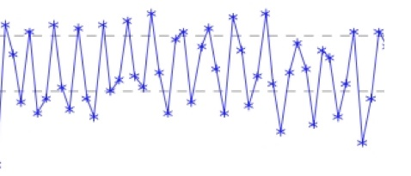
Temperature Tracings (from Primary Probe)
Not in range
AUTO Mode
NMB, Sedation
In range
GRADIENT VARIABLE Mode 10º C
NMB, sedation

Slide 43
3. Blanketrol and SMART MODE
GRADIENT VARIABLE with SMART MODE – Blanketrol-III
A modification to the GRADIENT VARIABLE MODE.
SMART MODE will decrease the water temperature set in GRADIENT VARIABLE MODE by 5ºC if the goal temperature is not achieved within 30 minutes.
It reverts to the GRADIENT VARIABLE MODE once the target temperature goal is achieved.
This mode is suggested to be used by the manufacturer (Gentherm).
See User Guide and Inservice videos updated since THAPCA.
https://www.gentherm.com/en/medical/hyper-hypothermia/blanketrol-3

Slide 44
3. Blanketrol-III
Manual Mode - Blanketrol-III
Not normally used except for emergencies
IMPORTANT: Key fact to know for Blanketrol! Manual mode is required if patient's (pt) tempis ever ≤30°C
None of the other Blanketrol Modes function if patient temp is ≤30°C
Suggest setting the Manual Mode to highest (warmest) setting (42°C) briefly until the pt temp is 33°C. Then use Auto Control of a Gradient Variable SMART Mode depending on patient size
*IMPORTANT - In the Manual Mode, the bedside nurse must continuously observe the pt’s temp. The pt is 100% dependent on careful temp titration by nurse.

Slide 45
Protocol Overview Through 120 Hours

Slide 46
Overview – from 37,000 feet
Example – University of Michigan PICU
PICU fellow is contacted re: an OHCA from outside ED or our UM ED.
The research team on call is immediately notified of a pending OHCA admit.
Research team discusses with clinical team the case summary, arrival time, and approach for consent
Order for nursing to get cooling equipment to bedside:
Blanketrol-III, two Maxi-Therm Lite cooling blankets (Ped or Adult), 2 hoses, 2 temperature probes and temp sensing Foley of correct size
On pt arrival, clinical team stabilizes, places CVC, art line.
Cooling device started as soon as it is safe to do so.
Clinical team initiates their usual TTM target between 33-37ºC before consent.

Slide 47
Overview – from 37,000 feet
Research team gets informed consent and randomizes to 1 of 3 cooling durations (24, 48 or 72 hrs) for first 150 pts (“burn-in” phase).
Subject enrollment = time randomized to a study cooling duration.
TTM 33°C will be set as the target temp no later than 15 min following randomization.
If it was started prior to randomization, then the start time for cooling will be when a target 32-34°C range was set.
Protocol goal is to achieve a temp range of 32-34°C no later than 2 hr. after randomization.
Sedation and NMB for induction phase results in fastest time to goal

Slide 48
Overview – from 37,000 feet
Cooling duration is equal to the combined time of the Induction plus Maintenance phases.
After the cooling duration is completed, slow rewarming over at least 16 hrs. is done.
Then normothermia 36.8°C for rest of 120 hr.

Slide 49
Durations of Cooling in P-ICECAP
Patient Timeline 0 - 120 Hours

Slide 50
Cooling Duration
Different than how it was defined in THAPCA.
Cooling duration - Induction Phase + Maintenance Phase combined times. Starts when cooling device is set at target of 33°C [32-34 °C]. Ends when planned rewarming starts.
Induction phase – starts when cooling device is set to the target temperature of 33°C post randomization (or 32-34°C range pre-randomization) and ends when the range of 32-34°C is achieved. Goal < 2 hrs.
Maintenance phase – the remaining time to complete the assigned cooling duration. Ends at the start of rewarming.
For the first 150 patients in P-ICECAP, the cooling durations will be 24, 48 or 72 hours only. (All patients cooled). Other cooling durations (0 to 96 hrs.) will be added in Year 3.
DCC will provide sites with the exact time to begin rewarming.

Slide 51
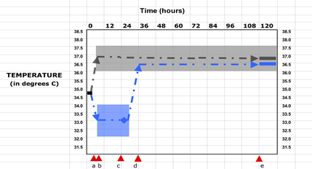
24 Hour Cooling Duration
Timepoints
a | randomization to Hypothermia (blue) or Normothermia (gray)
a - b | interval to assigned temperature goal range
a - c | duration of cooling assigned in hr
c - d | rewarming of cooled group
d - e | interval of controlled normothermia through 120 hr
e | end of study temperature control

Slide 52
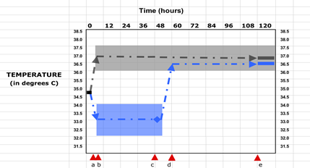
48 Hour Cooling Duration
Timepoints
a | randomization to Hypothermia (blue) or Normothermia (gray)
a - b | interval to assigned temperature goal range
a - c | duration of cooling assigned in hr
c - d | rewarming of cooled group
d - e | interval of controlled normothermia through 120 hr
e | end of study temperature control

Slide 53
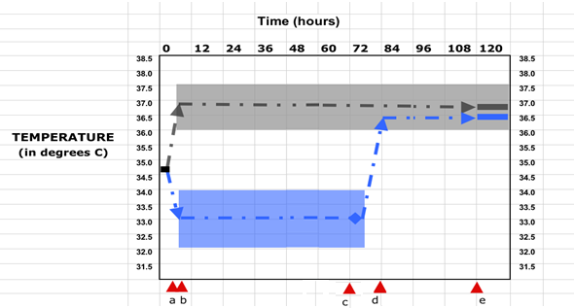
72 Hour Cooling Duration
Timepoints
a | randomization to Hypothermia (blue) or Normothermia (gray)
a - b | interval to assigned temperature goal range
a - c | duration of cooling assigned in hr
c - d | rewarming of cooled group
d - e | interval of controlled normothermia through 120 hr
e | end of study temperature control

Slide 54
Review: Cooling Duration
Duration of cooling starts when the target temperature on the cooling device is set to 33°C (range 32-34°C)
Goal: start 33°C target temperature <15 minutes post randomization.
If cooling device’s set temp is between 32-34°C before randomization (because this is the site TTM practice), then the start time for duration of cooling is pre-randomization. After randomization, the target should be set at 33°C.
Duration of cooling ends at the start of planned rewarming
Equals Induction + Maintenance combined time

Slide 55
Temperature Monitoring and Management

Slide 56
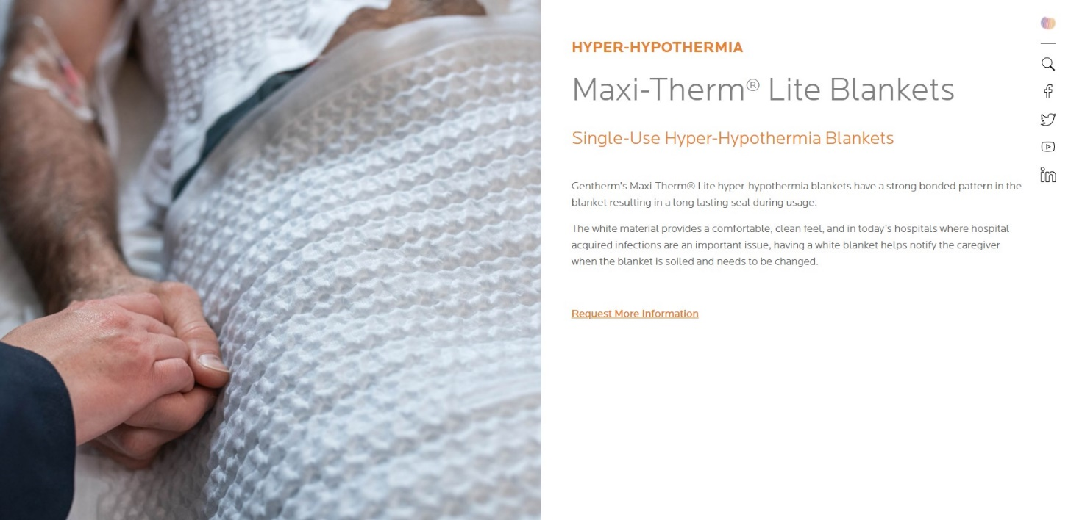

Slide 57
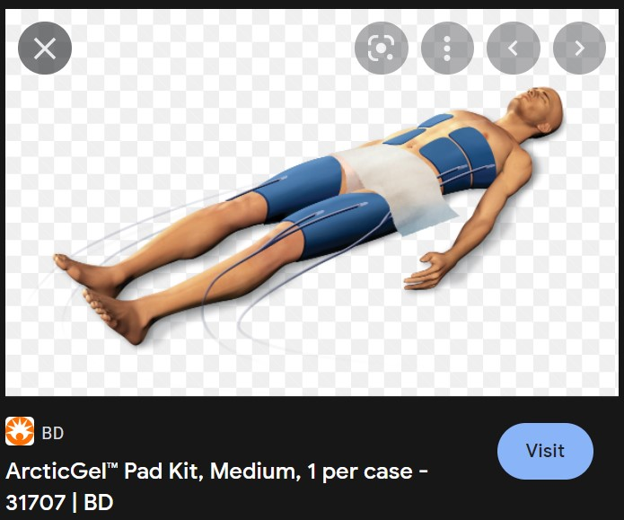

Slide 58
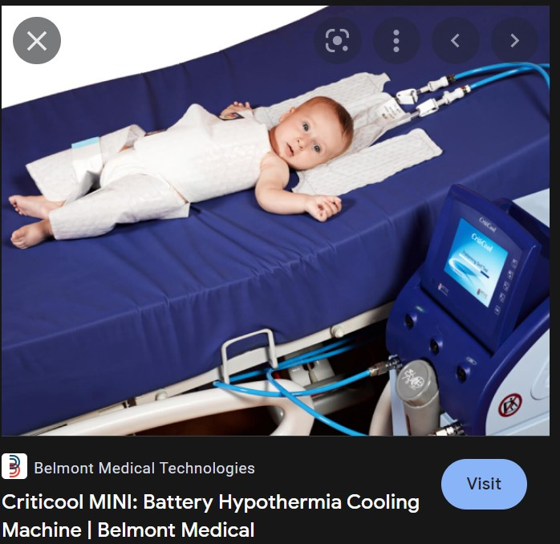

Slide 59
Monitoring: TTM 33°C (32-34°C)
Two central temperature probes.
Primary to cooling device (Blanketrol-III, Arctic Sun, other).
*This temperature is entered into the case report form (CRF).
Secondary to bedside monitor or device (safety).

Slide 60
Monitoring: TTM 33°C (32-34°C)
Cooling device’s target temp is 33°C (range 32-34°C) until rewarming. Different devices have different settings/modes for small to large sized patients.
If temp is not staying in the 32-34°C range, need to adjust cooling device per manufacture (e.g., next slide).
Arctic Sun (excellent hands-on support)
Blanketrol-III (good online instructions & videos)
Both have 24/7 hotline numbers for support.
The on-call P-ICECAP team has 24/7 hotline that is available for other study questions.
We will collect temp information hourly after the first central temp probe is placed until end of TTM or the probe is removed. (FDA request).

Slide 61
Temperature tracings from small child (primary probe)
Not in 32-34ºC range
AUTO Mode
NMB, Sedation
In range
GRADIENT VARIABLE Mode 10ºC
NMB, sedation

Slide 62
Temperature Management
A major goal in P-ICECAP is to achieve the desired phase target temperatures for the 120-hour intervention while preventing shivering.
Sedation and analgesia are generally used throughout the120 hours while a patient remains intubated.
NMB use for Induction and Rewarming phases. Other times PRN.
Subclinical shivering is common. In patients with difficult to maintain temperature, consider sedation with NMB trial.

Slide 63
Temperature Management
Sedation/analgesia and NMB for Induction Phase until a stable goal 33°C target.
The goal clinical response is “sluggish or no response to noxious stimulus.”
Common sedatives midazolam and dexmedetomidine.
Common analgesics fentanyl and morphine.
Common NMB agents vecuronium and rocuronium.
Twitch monitoring as needed
Infusions and intermittent dosing per site practice
After the goal temperature range is achieved and stable, may hold NMB and dose prn through the Maintenance Phase. Titrate sedation/analgesia to above goal.

Slide 64
Temperature Management
Sedation/analgesia and NMB are also key during the Rewarming Phase. This facilitates slow controlled temp increase to the normothermia target 36.8 °C.
Increased doses of sedatives/analgesics and NMBs may be required during rewarming as drug clearance increases at higher temperatures.
See Clinical Practice Guidelines

Slide 65
P-ICECAP Trial: Cooling, Rewarming and Normothermia Phases

Slide 66
Cooling Groups: 24, 48, and 72 hour
Induction Phase (I)
Time from start of TTM 33ºC (or 32-34ºC if pre randomization) until the goal range (32-34ºC) is reached.
Use the recommended cooling modes described by manufactures for the patient’s size.
Blanketrol III - AUTO CONTROL or GRADIENT VARIABLE SMART MODE – per manufacturer.
Arctic Sun – per manufacturer.
Induction will require sedation + analgesia and NMB
Likely time of maximum BP instability following OHCA since closest to event
Hypovolemia, Hypokalemia and Hyperglycemia may occur during this period
Review issues with clinical team optimal

Slide 67
Cooling Groups: 24, 48, and 72 hour
Maintenance Phase (II)
Steady state period with target temperature 33ºC (32-34ºC) until assigned study cooling duration is completed and planned rewarming starts.
Adjust the cooling device mode as needed per manufacturer.
Titrate sedation/analgesia to achieve/maintain “sluggish or no response to noxious stimulus.”
NMB prn after stable 32-34ºC temp range is achieved.
Similar clinical issues as Induction Phase possible (Hypovolemia, Hypokalemia and Hyperglycemia).

Slide 68
Cooling Groups: 24, 48, and 72 hour
Rewarming Phase (III)
This is a critical time – it needs to be done slowly.
Begins with the initiation of planned increase of device target temperature toward 36.8ºC (normothermia) goal.
Should be done over ≥16 hrs
For Blanketrol-III: AUTO CONTROL or GRADIENT VARIABLE SMART MODE
Manually Increase temp set goal 0.7 ºC every 4 hrs.
33ºC (0 hr); 33.7ºC (0-4hr); 34.4ºC (4-8hr); 35.1ºC (8-12hr); 35.8ºC (12-16hr); then 36.8ºC (16+hr)
Goal temp of 36.8ºC (36-37.5ºC range) after 16 hrs
For Arctic Sun – the rate of rewarming is programed to achieve the goal of 36.8ºC (from 33ºC) over 16-18 hr.

Slide 69
Cooling Groups: 24, 48 and 72 hour
Normothermia Phase (IV)
Goal temp is 36.8°C, range 36-37.5°C for remaining time to 120 hrs
If clinical team determines they must check fever status, put in MONITOR ONLY Mode
Return to the device’s appropriate cooling mode if temp > 37.5°C, but only if the patient remains intubated. Sedation/analgesia and possibly NMB may be required to prevent shivering

Slide 70
Cooling Groups: 24, 48, and 72 hour
Normothermia Phase (IV)
Clinical team may elect to extubate patient if clinically awake and otherwise stable
Management of fever following extubation is limited to antipyretic agents (Tylenol). Will NOT be able to deeply sedate or use NMB to prevent shivering.
If afebrile, could use MONITOR Only Mode
*IMPORTANT: Do NOT extubate a patient until rewarmed! Cerebral edema, hypoglycemia, hyperkalemia, and hypotension are risks of rapid rewarming.

Slide 71
Initial Site Enrollments
For the first 2 patients enrolled from each site, we recommend you contact the on-call 247 P-ICECAP hotline to review the Induction Phase soon after device is set to 33°C. Call again just prior to start of the Rewarming Phase.
This was done successfully in THAPCA.
Since sites are using their own cooling devices, we are relying on sites and manufacturers to have expertise for using their cooling equipment safely. Contact your vendor for an in-service if you believe it would benefit your PICU/PCCM team.
Arctic Sun may have already contacted you.
Contact Gentherm (Blanketrol) and other manufactures as needed for in-services.

Slide 72
Questions?

