Slide 1
History and Overview
Dr. William Meurer

Slide 2
Questions
Why be adaptive?
Why study hypothermia?
How will trial work?

Slide 3
P-ICECAP
A randomized, response-adaptive, duration-finding, comparative effectiveness clinical trial with blinded outcome assessment.

Slide 4
Part 1
INTRODUCTION TO ADAPTIVE CLINICAL TRIALS

Slide 5
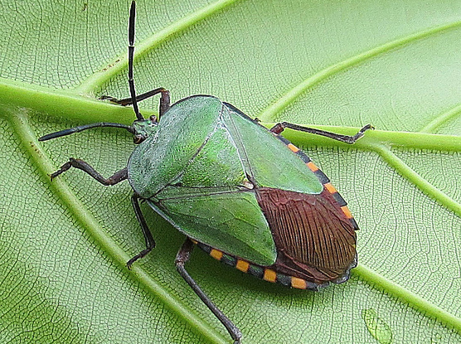
Why Clinical Trials Stink

Slide 6
Why Clinical Trials Stink
ANALOGY*: Clinical Trial = Diagnostic Test
 | Clinical Trial | Diagnostic Test
Looking For | Effective Treatment | Disease
1 – Type II Error (Beta) | “Power” | Sensitivity OR True Positive Rate
Type I Error (Alpha) | Significance Level | 1- Specificity OR FALSE Positive Rate
*Note: My analogy does not stink

Slide 7
Clinical Trials are Models with Tons of Guesses Assumptions
Dose from animal models is close
No heterogeneity of effect
Subgroups respond equally
Some subgroups excluded
Effect size to create “reasonable” sample size
“Noise” in outcomes can be understood and overcome
Duration of treatment practical
LESSON: Make many compromises to reduce number of parameters to make model “solvable”

Slide 8
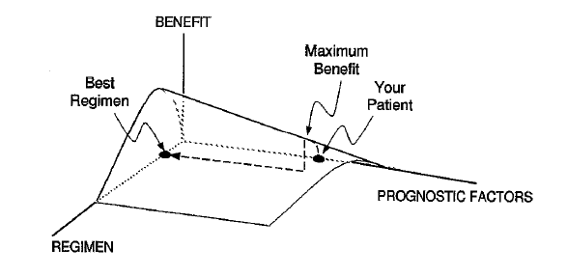
Therapeutic Response Surface
Clin Pharmacol Ther 1997;61:275-91
Notes:
In a commentary by Lewis Sheiner from UCSF, he describes the idea of what we are looking for in a clinical trials. This is a gross oversimplification, but you can think of the regimen axis as containing information on everything about the drug or device including dose, how long to treat, concomitant therapies. The prognostic axis contains all the important ways that patients differ in their outcome either with or without the treatment. The vertical, benefit axis signifies the NET efficacy with toxicity subtracted off. This plane will be flat with zero benefit for a treatment that has no effect on anyone. It is important to point out that this is a biological description and when we conduct clinical trials we are trying to find parts of this surface, but we will never estimate something like this fully with a high degree of accuracy.

Slide 9
Preclinical Experiments
Mechanism /Theory
Targets / Knowledge
Translational / Behaviors
Clinical Trials
Efficacy / (?Effectiveness)
“Safety” / Feasibility*/Cost
Dose Ranging / Regimen Finding

Slide 10
The Adaptive Process
Begin Data Collection with Initial
Allocation and Sampling Rules
Analyze
Available Data
Continue Data
Collection
Stopping
Rule Met?
No Yes
Revise Allocation
and Sampling Rules
per Adaptive Algorithm
Stop Trial or
Begin Next
Phase in
Seamless
Design

Slide 11
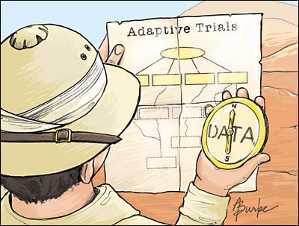
The Adaptive Process
JAMA 2006;296:1955-1957.

Slide 12
GOAL:
Design a trial that leaves no (or few) regrets.
The clinical community and funders will know what to do next.
The “pre-mortem.”

Slide 13
CAVEAT:
An adaptive or flexible design doesn’t always make sense.
(We do not usually know as much before starting the trial as we will after we have data for most situations…)

Slide 14
ADAPT-IT 2010-2012
FDA / NIH Common Fund cooperative award that to develop adaptive clinical trial designs for confirmatory, large scale trials
Process
Stakeholder Meeting to present the clinical problem
Preliminary design - Simulations and iterations
Stakeholder Meeting to review “final” design proposal
More simulations and validation
Development of protocol (IDE / clinical trial protocol)
Notes:
The innovative adaptive clinical trial design for ICECAP was made possible because of an FDA / NIH cooperative award for a project that we called ADAPT-IT involving the Berry Consultant group, experts in adaptive trials, and clinical investigators recruited and organized through NETT. The project was designed to encourage application of adaptive methods to the confirmatory clinical trial space, and to develop and study the processes for engaging regulatory and academic stakeholders, and their acceptance of these methods.
The project led to the design and simulation of ICECAP and four other clinical trials. In a nutshell, the process involved a series of meetings in person and by conference call. Stakeholders including the investigators, NIH program scientists, and FDA regulators presented the clinical problem. Berry Consultants then proposed a preliminary design and simulations, which then evolved through iterative rounds of feedback and modification with the investigators. The larger stakeholder group was then reconvened to review and comment on a near final design. It was in this stage that the importance of studying the population of patients with non-shockable rhythms was emphasized by enough stakeholders that this was incorporated into the trial.
ADAPT IT allowed for the extensive simulation needed for this kind of complex trial.
This support allowed us to prepare all the preliminary data necessary to submit an IDE application and obtain a “may proceed” letter from FDA. Because of ADAPT-IT we have already have FDA approval and are ready to hit the ground running.

Slide 15
Thematic Adaptive Motivation for (adult) ICECAP
Fixed design
1800 patients
12, 24, 48
Anticipated regrets

Slide 16
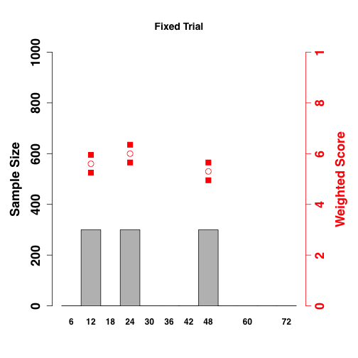
Example Outcome of Fixed
Idealized Outcome?
Answer All your questions?
Do anything differently?

Slide 17
Example Outcome of Fixed (versus “truth”)
Later Effect
“Perfect”
Earlier Effect

Slide 18
Example Outcome of Fixed (versus “truth”)
FDA Approval?
Medical Controversy?
Different rhythm types?
2 more Studies?
Null
Harm
Null/Harm

Slide 19
PRECLINICAL / PRIOR CLINICAL EVIDENCE
Part 2

Slide 20
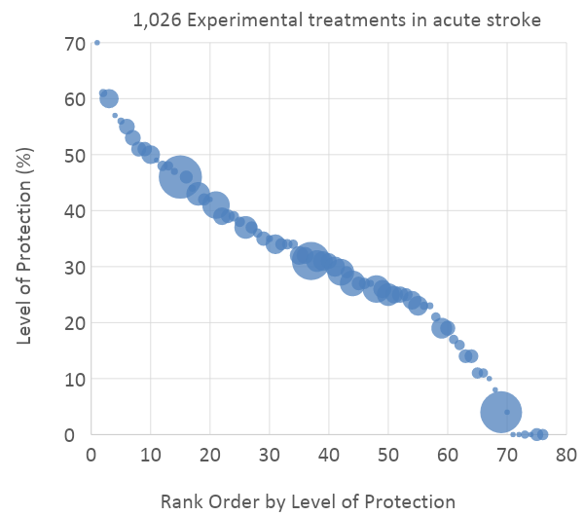
Ann Neurol 2006;59:467–477
 | Experimental Contrasts (n)
Focal Ischemia Models | 94 | favors treatment
 | 28 | neutral
 | 0 | favors control
Global Ischemia Models | 77 | favors treatment
 | 28 | neutral
 | 0 | favors control
Culture Models | 13 | favors treatment
 | 3 | neutral
 | 1 | favors control
Notes:
Graphically, their data looks like this. The interventions are ranked on effectiveness and the size of the bubble shows the number of trials analyzed. The large green dot represents hypothermia, with a high level of efficacy, only beaten by a few other interventions that were never ultimately reproduced.
The table on the right shows that efficacy was in both focal and global cerebral ischemia animal models in most experiments, and in few cell culture models.
The papers they didn’t report on were basic science papers exploring mechanism rather than outcome. So what do those show?

Slide 21
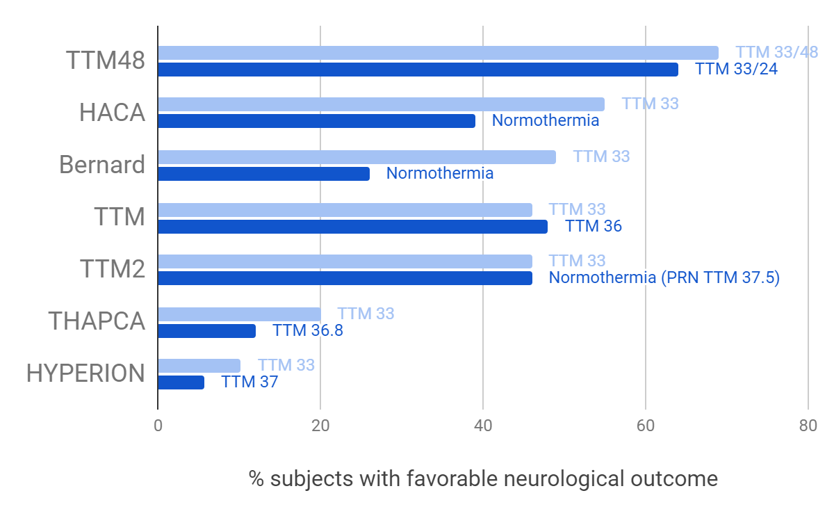

Slide 22
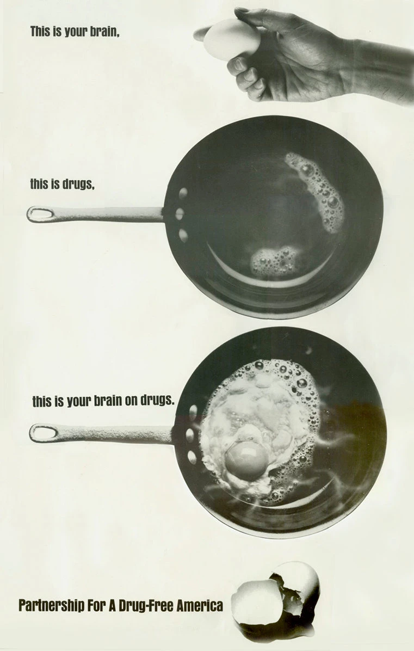
The brain is sensitive to temperature
Drugs = HYPERTHERMIA

Slide 23
History / Timeline
2003 THAPCA pre trial cohort study R21
2006 THAPCA R34
2009 THAPCA OH and THAPCA IH Trials U01
2011 ADAPT-IT - ICECAP planning
2013 THAPCA Last Outcomes Collected
2015 THAPCA OH - Publication
2016 ADULT ICECAP IDE
2020 ADULT ICECAP First Patient In
2021 P-ICECAP IDE (initial)
2021 P-ICECAP Award
2022 (Now)

Slide 24
THAPCA-OH - Design
Prospective RCT
Out of hospital cardiac arrest
GCS motor 4 OR less
48 hours of TTM to 33°C versus enforced 36.8 °C / 120 hours of TTM total in both
Primary outcome: Survival with a good neurobehavioral outcome at 12 months of follow-up

Slide 25
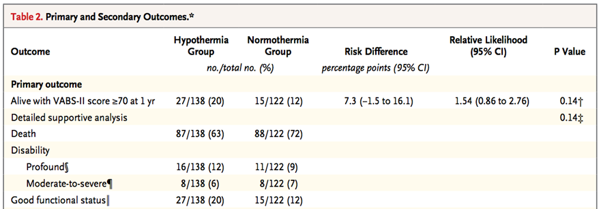
THAPCA-OH
20%
12%

Slide 26
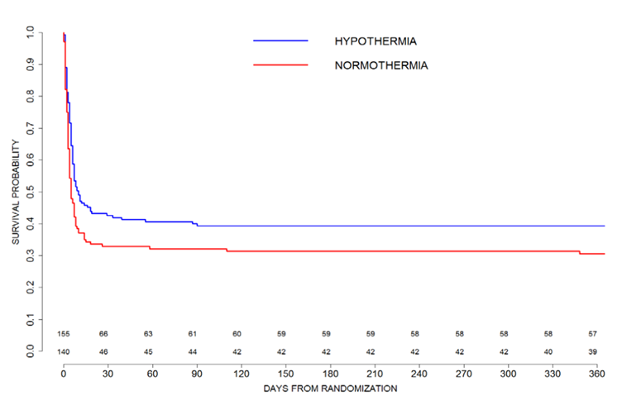
Figure S1 from THAPCA-OH: Probability of survival to one year following cardiac arrest, according to assigned treatment
The two lines represent Kaplan-Meier survival rates from 0 to 365 days after cardiac arrest for patients in each study arm (p=0.04 for a log-rank test, stratified by age category, comparing survival distributions between treatment arms).

Slide 27
P-ICECAP OVERVIEW
Part 3

Slide 28
Specific Aim 1: Can the efficacy of hypothermia be confirmed by evaluating duration response?
To determine in pediatric comatose survivors of OHCA, whether the duration response curve as assessed by the VABS-3* mortality composite score is initially increasing, thus demonstrating efficacy of hypothermia versus normothermia (i.e. zero duration of cooling). Secondary endpoints include the Pediatric Cerebral Performance Category Score, Pediatric Resuscitation after Cardiac Arrest score, and survival at 12 months.
*Vineland Adaptive Behavioral Scale 3 - a standardized measure of neurobehavioral functioning

Slide 29
Specific Aim 2: Can the optimal duration of cooling be identified?
To determine in pediatric comatose survivors of OHCA, the shortest duration of cooling that provides the maximum treatment effect as determined by a higher VABS-3 Mortality Composite Score.

Slide 30
Specific Aim 3: Does duration have a differential effect on safety and quality of life?
To characterize the effect of duration of hypothermia on overall safety and adverse events, and parent reported quality of life.

Slide 31
P-ICECAP Comparison to Adult ICECAP
Aspect | P-ICECAP | Adult ICECAP
Durations (hours) | 0-96 (10) | 6-72 (10)
Eligibility Timing | Within 6 hours of ROSC - must start device before randomization must set device to 33°C within 15 minutes | Must be below 34°C within 4 hours of arrest
Sample Size | 900 | 1800 (with different models / randomization vectors for shockable versus non-shockable)
Outcome Timing | 3 and 12 months | 1 and 3 months
Sites | 40 (with more needing FDA approval) | Up to 75

Slide 32
P-ICECAP Comparison to THAPCA
Aspect | P-ICECAP | THAPCA
Duration of cooling (hours) | 0 to 96 (10 durations) at 33°C | 48 at 33°C or 36.8°C
Eligibility GCS Motor | 5 or lower (more inclusive) | 4 or lower (less inclusive)
Sample Size | 900 | 295 randomized (260 eligible for primary outcome)
Outcome Timing | 3 and 12 months | 3 and 12 months
Outcome | VAB3 mortality composite (continuous) | VABS2 >= 70 and alive = good (binary)

Slide 33
Inclusion
Age 2 days to <18 years with corrected gestational age of at least 38 weeks
coma or encephalopathy after return of spontaneous circulation (ROSC) following out-of-hospital cardiac arrest;
requiring mechanical ventilation;
definitive temperature control device started;
informed consent from legally authorized representative (LAR) including randomization within 6 hours of ROSC;
intent to maintain life support for 120 hours

Slide 34
Exclusion (Major)
Glasgow Coma Motor Score (GCMS) of 6,
severe hemodynamic instability;
pre-existing condition confounding outcome determination
pre-existing terminal illness;
planned early withdrawal of life support before 120 hours;
pre-existing contraindication to cooling*;
CPR duration > 60 minutes;
Prisoner;
KNOWN pregnancy

Slide 35
Intervention
Duration 0-96 hours
Measured from definitive cooling initiation and being set to 33° C (or normothermia if assigned to no additional cooling)
Any definitive surface, servo controlled cooling device*
Clinical standardization

Slide 36
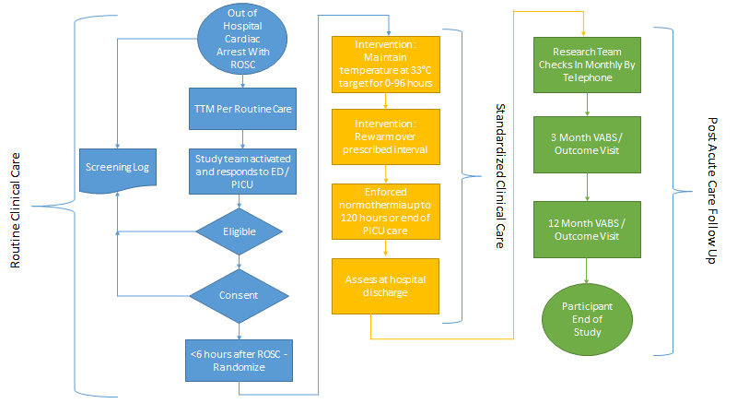
Enrollment and Patient Flow

Slide 37
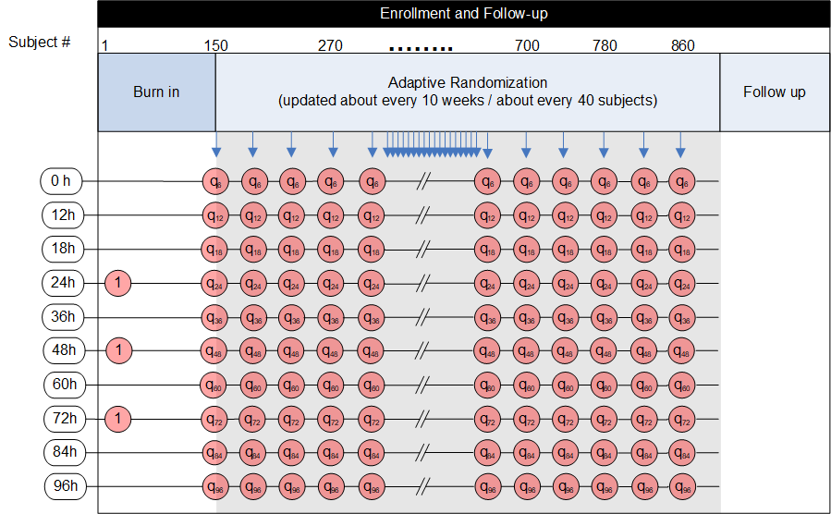

Slide 38
Why be adaptive
-To get closer to the “truth”
-To put kids where they will do best
-To avoid cooling kids too much (or too little)
-First 150 kids - equal allocation 24,48,72 (reduce noise)

Slide 39
Primary Outcome:
VABS-3 - Mortality Composite Score
Vineland Adaptive Behavior Scale - Third Edition
Standardized caregiver report measure of neurobehavioral function appropriate from birth through adulthood

Slide 40
Primary Outcome:
VABS-3 Mortality Composite Score
Measured VABS-3 composite scores range from 20-140 (mean=100, SD=15).
Patients who die before 12 month outcome assessment will be assigned zero
Used continuously to simultaneously account for mortality and neurological status

Slide 41
Other Outcomes
PCPC (Pediatric Cerebral Performance Category)
PedsQL (Pediatric Quality of Life Inventory TM)
Family Burden
Structured Neuro Exam
Mortality at 12 months

Slide 42
Safety Outcomes (anticipated)
Infection (pneumonia, UTI, BSI, culture positive bacterial sepsis and other culture positive infections)
Life-threatening cardiac arrhythmias requiring intervention (cardiac arrest, ventricular fibrillation, ventricular tachycardia, atrial arrhythmias with hemodynamic compromise)
Coagulopathy Increased bleeding requiring blood product replacement
Neurological worsening (i.e. cerebral edema and herniation, intractable status epilepticus, cerebral hemorrhage, cerebral infarction)

Slide 43
QUESTIONS?

