Slide 1
OUTCOMES TRAINING
The How, When, Where and Why of Outcomes Procedures

Slide 2
What does “P-ICECAP Outcomes” mean?
Information at Baseline
3-Month VABS-3
12-Month VABS-3
12-Month Neurologic exam

Slide 3
Information at Baseline
POPC and PCPC – Pediatric Overall Performance Category and Pediatric Cerebral Performance Category
Family and Household Information
Peds QL – Pediatric Quality of Life Survey
Baseline Contact Form
Within 48 hours

Slide 4
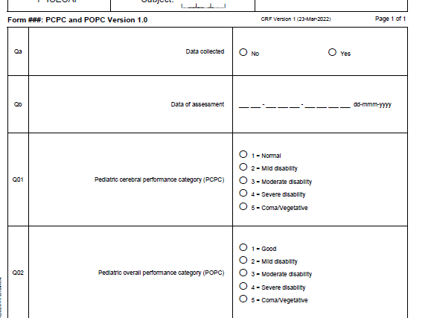

Slide 5
POPC and PCPC (baseline and 30 day/DC)
Decision Tree for Determining Level of Impairment on Both the PCPC and POPC:
Normal/Good = If the child has no disability or medical conditions, and is functioning appropriately, the child should be classified as “Normal” on the PCPC and “Good” on the POPC.
Mild Disability = If the child has minor delays or functional impairments and most skills are within age-appropriate limits, or the child has well-controlled medical conditions, the child should be classified as “Mild Disability”.
Moderate Disability = If the child is significantly delayed or functionally impaired in most areas and demonstrates some level of independence in activities of daily living, the child should be classified as “Moderate Disability”.
Severe Disability = If the child is responsive to the environment but dependent on others for daily support because of impaired brain functioning or other medical conditions (excluding age), the child is classified as “Severe Disability”.
Coma/Vegetative State = If the child has any degree of coma, is unaware and unresponsive, even if awake in appearance, without interaction with environment, the child is classified as “Coma/Vegetative State”.

Slide 6
How to gather information for Baseline POPC & PCPC
Review the medical record for the pre-CA level of impairment, medical conditions, AND etiology of the delays of functional impairments. (baseline: well-child visits)
If you cannot find information in the record, please ask the caregiver about any medical diagnoses or conditions the child had prior to the cardiac arrest.
For all identified diagnoses or conditions, please ask whether the diagnosis/condition limited the child’s functioning (prior to the cardiac arrest) in any way.

Slide 7
Family and Household Information
This is a simple one-page form that you can hand the caregiver to complete.
The family may be so distressed that you may need to do this interview-style.
We don’t recommend leaving it with the family to complete at their convenience– you’ll probably never see it again.
Toolbox | SIREN

Slide 8
Pediatric Quality of Life Inventory (“Peds QL”)
You must pick the correct form for the age of the child.
These forms are in the P-ICECAP Website Toolbox
Toolbox | SIREN

Slide 9
Baseline Contact Form
Collect as much information about contacting the family on this form as you can.
This is a ‘living document’ for you to keep at your site and share with Kennedy Krieger Institute (KKI) via Dropbox when appropriate.
This form does not get entered into webDCU – PHI!
This is why we are using a secure Dropbox. (instructions forthcoming)
The Contact Form is in the toolbox as well. Toolbox | SIREN
There is also a Contact Tracking Log for you to use to track how and when you have reached out to families. Useful to have if the CCC has questions for those families that seem hard to reach.

Slide 10
!!!!!At 2 months and 11 months!!!!!
At 2 months and at 11 months you will reach out to family, update the form if needed, and then load the form/updated form to the secure dropbox.
For both timepoints you can already schedule the interview if the family is willing. Add this information to your contact form. They should expect a call from a 443-923-XXXX
number
For the 11-month time point, include on the contact form when the neurologic exam is.
***** The 12-month VABS MUST be completed before the neurologic exam*****
KKI (Beth Slomine and Nisha Amin) will retrieve the Contact form from the Dropbox at those timepoints and use the information to contact the family for the 3-month and 12-month VABS-3 surveys. They may reach out to you if there are questions. Please respond quickly if they do!

Slide 11
The 12-month Neurologic exam
The Neurologic Exam Form in webDCU is called the PRCA (Pediatric Resuscitation after Cardiac Arrest) Score.
The RC should reach out to the site’s neurologist early to set up the 12-month exam because clinics can fill up way in advance. Get your participant appointment set up early!
REMEMBER – the 12-month VABS-3 must be completed BEFORE the neurologic exam.
WINDOWS: if you look on the Schedule of Assessments, there are windows for the VABS-3 and neurologic exam (+/- 15 days) so plan your VABS-3 date early in the window and the neurologic exam after that.

Slide 12
The 12-month Neurologic Exam cont
There will be a brief orientation in fall for all neurologists doing the 12-month exam
If your site has not yet identified a neurologist, please do so and send the contact information to Dr. Frank Moler (fmoler@med.umich.edu) and Dr. Faye Silverstein (fsilvers@med.umich.edu)
On the day of the 12-month neurologic exam, print out the PRCA from webDCU and hand it to the neurologist.
As soon as you get it back LOOK IT OVER CAREFULLY! If anything is blank, follow up right away.
You will be entering this form into webDCU.

Slide 13
(A note about P-ICECAP and days)
Day 1 visit is from initiation of temperature control device through the end of the calendar day (23:59). (this will be before randomization!)
Day 2 visit is the next day 00:00 through 23:59.

