Slide 1
Returning to the study protocol with GlucoStabilizer

Slide 2
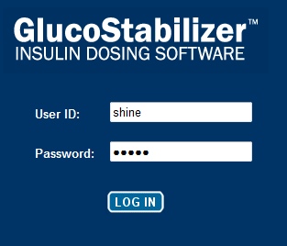
Accessing your study patient again
Select SHINE icon on desktop to access SHINE trial portal
Click box for intervention or control group
Enter shine/shine to access GlucoStabilizer

Slide 3
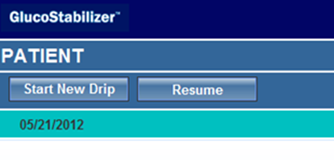
Do you need to Start New Drip or Resume?
> 3 hours – Start New Drip
<3 hours – Resume

Slide 4
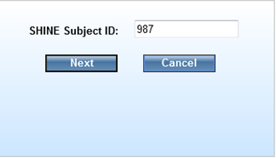
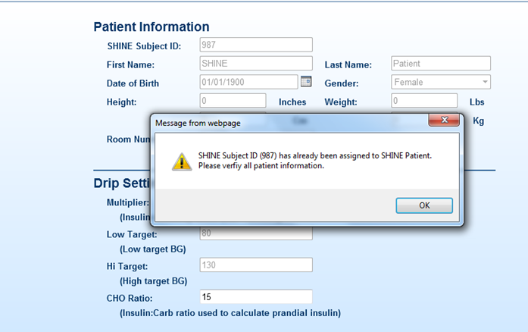
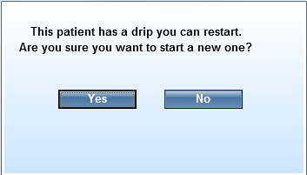
Starting New Drip (> 3 hours)
1 | 2
3 | 4

Slide 5
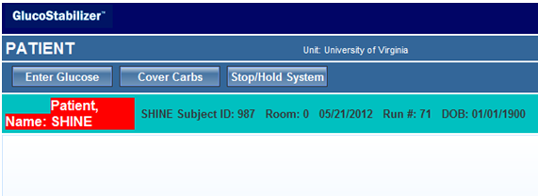
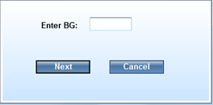
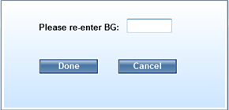
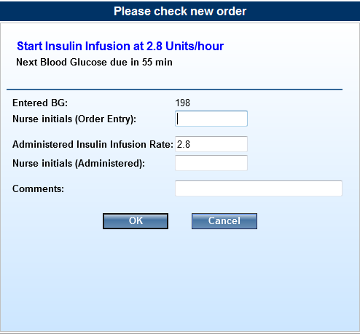
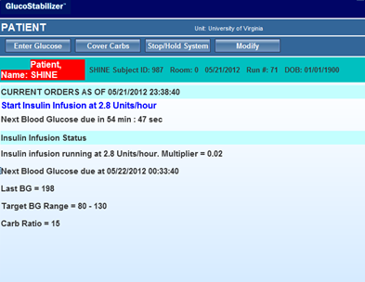
Starting New Drip (> 3 hours)
5 | 6
7 | 8

Slide 6
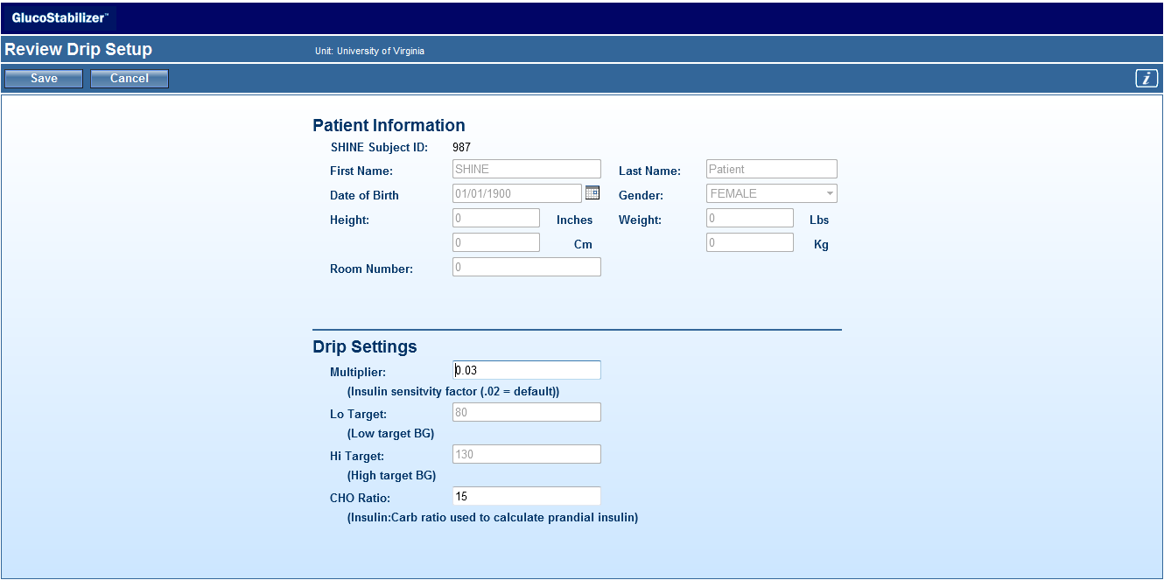
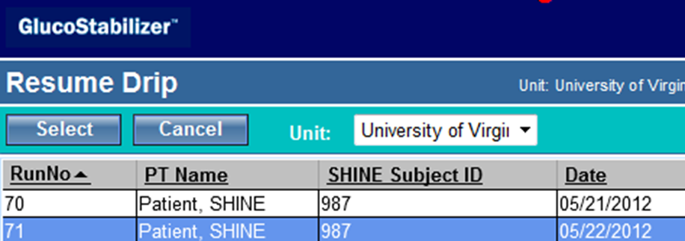
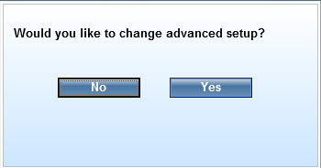
Resuming a Drip (<3 hours)
1 | 2
3 | 4

Slide 7
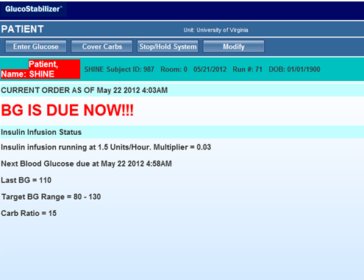
Resuming a Drip (< 3 hours)
5 | 6
7 | 8

