Slide 1
Stroke Hyperglycemia Insulin Network Effort (SHINE) Trial
I-SPOT
Nina Gentile, MD
Hannah Reimer

Slide 2
I-SP T
O
Insights on Selected Procoagulation markers and Outcomes in stroke Trial

Slide 3
I-SPOT
The Insights on Selected Procoagulation markers and Outcomes in Stroke Trial (I-SPOT) is an ancillary study to the Stroke Hyperglycemia Insulin Network Effort (SHINE) Trial

Slide 4
I-SPOT
Will compare blood coagulation factors between SHINE treatment and control patients
Will determine the relationship between levels of markers of blood coagulation and functional neurological outcome in SHINE treatment and control patients

Slide 5
I-SPOT & SHINE
I-SPOT nested within the SHINE trial
Only sites participating in the SHINE trial will be eligible to perform I-SPOT
Consent for I-SPOT embedded into SHINE consent

Slide 6
Patients eligible for I-SPOT
A subset of 315 patients enrolled in the SHINE study will be enrolled in the I-SPOT study

Slide 7
I-SPOT INC/EXC
I-SPOT Inclusion Criteria:
Able to provide a valid informed consent to be in the study (self or their legally accepted representative)

Slide 8
I-SPOT INC/EXC
I-SPOT Exclusion Criteria:
Anticipated use of systemic anticoagulants
Known moderate or severe hepatic insufficiency (as defined by INR>1.5 if known or history of variceal bleeding or hepatic encephalopathy)
Prior or concurrent thrombotic or hypercoagulable condition (Antiphospholipid antibody syndrome; Antithrombin III, Protein C or S deficiencies; Congenital or Inherited Factor deficiencies; Sickle cell disease)

Slide 9
I-SPOT EXCLUSION: SYSTEMIC ANTICOAGULANTS
IV or IA fibrinolytics
Warfarin
IV heparins
Full dose heparins for known DVT
Direct thrombin inhibitors
GIIB / IIIA inhibitors, or factor Xa inhibitors

Slide 10
Patients on these meds can be enrolled
SQ DVT prophylactic heparin doses are allowed
ASA is allowed
Plavix is allowed

Slide 11
Blood Collection for I-SPOT: WHEN
Samples drawn at 2 time points
Baseline before study drug start and directly after randomization
and
48 hours (between 46 and 54 hours)

Slide 12
I-SPOT Blood Collection
Draw blood samples from a fresh venipuncture
If it is not possible to draw blood from a fresh venipuncture and is drawn from an existing line, at least 5 ml of blood must be discarded before obtaining samples
Collect blood through a needle no smaller than 21 gauge
Use Vacutainer® system to collect blood. DO NOT drip blood or use syringe to put blood directly into tubes

Slide 13
I-SPOT Blood Collection
Blood tubes should be filled without use of tourniquet
Some procoagulation measures are affected by tourniquet use
May use a tourniquet to find the vein then remove as tubes begin to fill
If unable to fill tubes without tourniquet present, please mark on the CRF

Slide 14
FILL BLUE TOP TUBES COMPLETELY TO ENSURE PROPER RATIO OF BLOOD TO SODIUM CITRATE

Slide 15
I-SPOT Blood Collection
After tubes fill, gently invert tubes 4 times to mix blood with sodium citrate
Blood may be processed immediately after it is drawn and centrifuge start time must be within 60 minutes of collection

Slide 16
Instructions are in rcf (g) NOT rpm
If your centrifuge is in rpm you must convert to rcf (g)
RCF (g) = 1.12 x Radius x (rpm/1000)^2
Helpful sites:
http://www.piercenet.com/files/TR0040-Centrifuge-speed.pdf
http://insilico.ehu.es/mini_tools/rcf_rpm.php
Check your centrifuge before collecting samples for I-SPOT

Slide 17
PROCESSING BLOOD
BEFORE TUBES GO INTO CENTRIFUGE, remove 2 ml of whole blood from any of the 3 tubes and divide between 2 cryovials
Centrifuge remaining 3 tubes of blood at 1500 RCF (g) for 20 minutes
Fill each of the cryovial tubes with approximately 0.3 ml of plasma
Care should be taken not to disturb the red cell layer during harvesting of the plasma.
BLOOD MAY NOT BE RESPUN

Slide 18
BLOOD MAY NOT BE RESPUN
We would rather have mixed or hemolyzed blood than blood being respun!

Slide 19
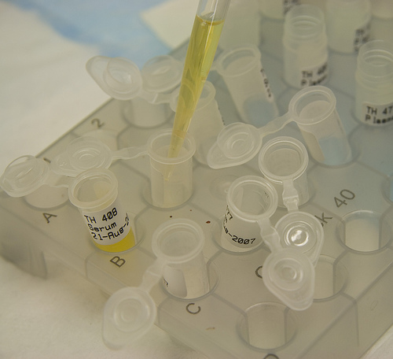
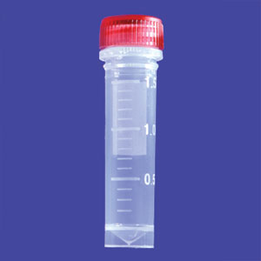
Label the cryovial tubes with the SHINE ID number, date and either ‘Baseline’ or ’48 hour’
Place caps on the cryovial tubes tightly
Record the number of cryovial tubes on Blood Sample Collection Form, for data entry into WebDCU

Slide 20
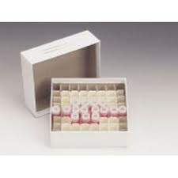
Processing Blood
Put only one one subject’s specimens in a single cryovial box
Place the cryovial tubes into the cardboard cryovial box and, using a permanent marker, label the box with the following information:
I-SPOT Study
Subject ID#
I-code number
Date and time blood collected

Slide 21
Storing Blood
Place the cardboard cryovial box containing the cryovial tubes into the freezer immediately at - 80°C (-70°C is acceptable) until ready to ship. Make sure the samples are frozen so that the cryovial tubes are upright
Do NOT lay the cryovial tubes on their side

Slide 22
Storing Blood
DO NOT take the cardboard cryovial box out of the freezer for the 48 hour samples until you are ready to place the cryovial tubes inside to prevent thawing of the frozen samples

Slide 23
SHIPPING BLOOD SAMPLES
I-SPOT Coordinating Center will e-mail when the I-SPOT samples should be shipped (within 30 days after an enrollment)
I-SPOT Coordinating Center will e-mail UPS airbill that will be printed and placed on the outside of the shipping box

Slide 24
Shipping Blood Samples
Make sure that the Baseline and 48hr are collected and placed in a single cryovial box for each subject before shipping

Slide 25
I-SPOT CONTACTS
Dr. Nina T. Gentile Project Director and Principal Investigator
Dr. A. Koneti Rao Principal Investigator
Dr. Anamika Singh Laboratory Manager
Hannah Reimer Project Manager

Slide 26
HOTLINE
For urgent I-SPOT issues please call the
I-SPOT hotline at:
774-23 I-SPOT
(774-234-7768)

