Slide 1
Stroke Hyperglycemia Insulin Network Effort (SHINE) Trial
Preparing Study Orders & Laptops
Amy Fansler
SHINE Project Director

Slide 2
Pharmacy Plan Overview
Pharmacy Plan Summary
Study treatments on formulary & storage
Procedure for randomization
Process for ordering and dispensing
Naming and labels
Study Orders
Medication
Communication/Physician to nurse orders

Slide 3
Study Treatments
 | Control Group | Intervention Group
IV Infusion | Normal saline 0.9% sodium chloride [Rate per Control Treatment Screen] | Human regular insulin Humulin R, Novolin R [Rate per GlucoStabilizer®]
SQ Injections | Human regular insulin Humulin R, Novolin R [Rate per Control Treatment Screen] AND Basal insulin (Level 3 only) glargine (Lantus) [40% previous 24 hr total insulin requirement] | Rapid acting analog insulin Lispro (Humalog), aspart (Novolog) or glulisine (Apidra) [Dose per GlucoStabilizer®] OR Normal saline 0.9% sodium chloride [0.05mL at ~0900/2100]
D50 | Dextrose 50% in water [25mL ( ½ amp) slow IV push q 15min BG<80mg/dL] | Dextrose 50% in water [Dose per GlucoStabilizer®]

Slide 4
Communication/Physician to Nurse Orders
Protocol must be documented
POC glucose checks
Meals
60 gram CHO diet
After check/SQ dose (control group)
Assess consumption (intervention group)
Hypoglycemia & severe hypergycemia protocol
Consider including
Pausing, interruptions, discharge, HbA1c, daily NIHSS

Slide 5
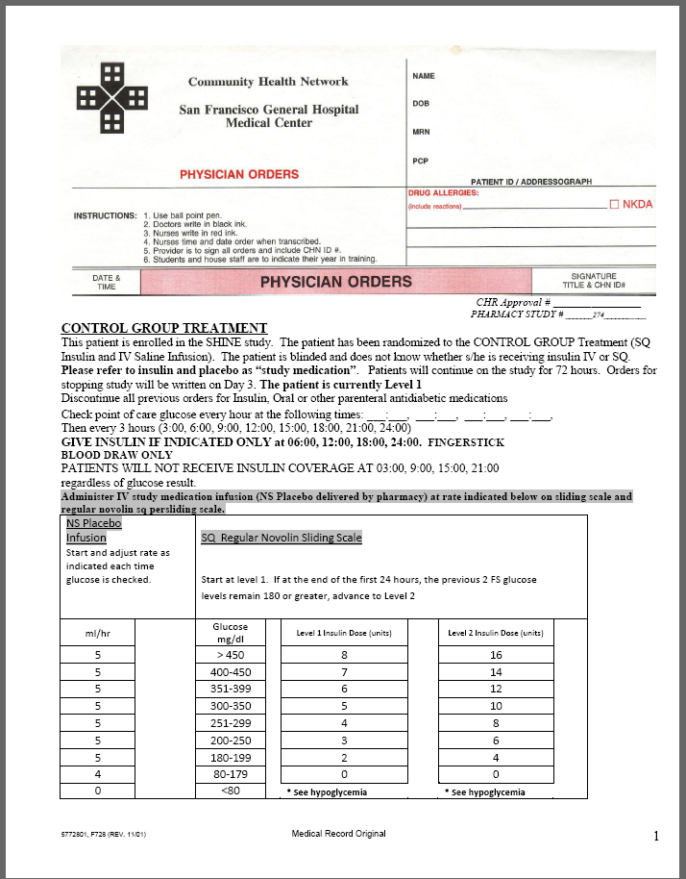
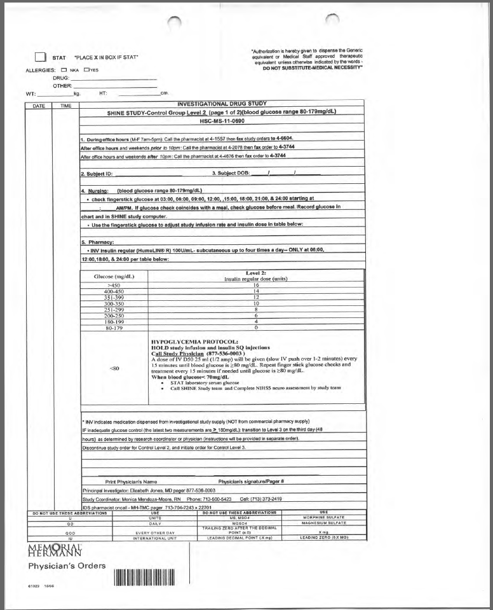
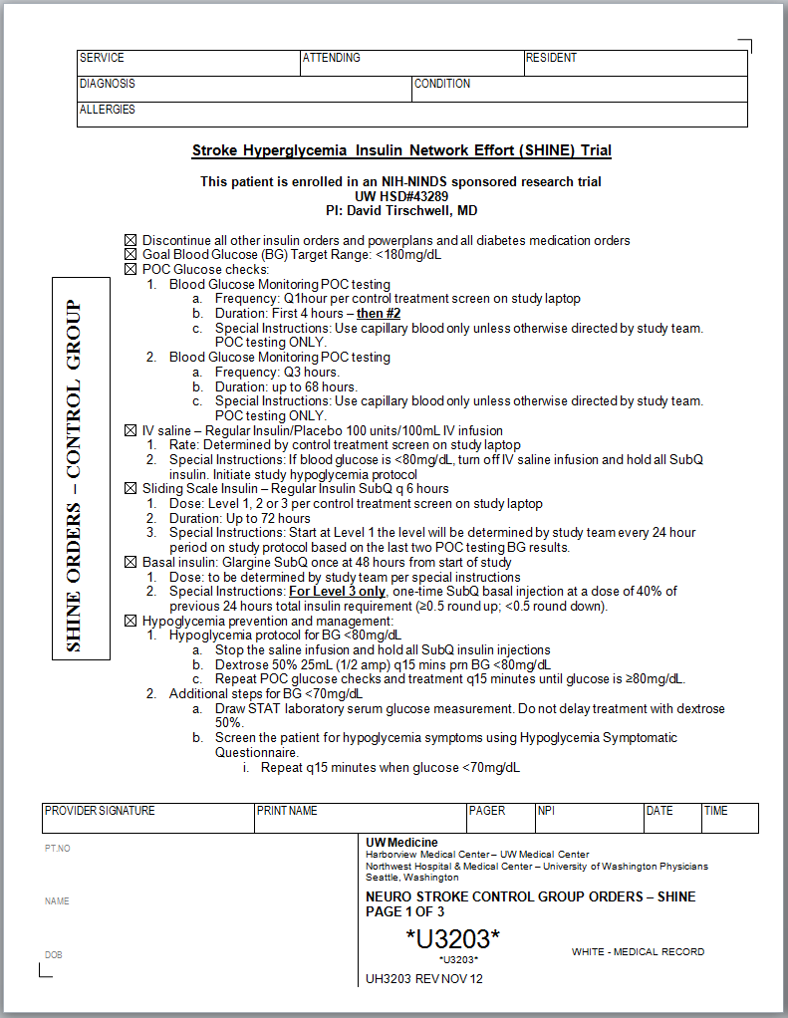

Slide 6
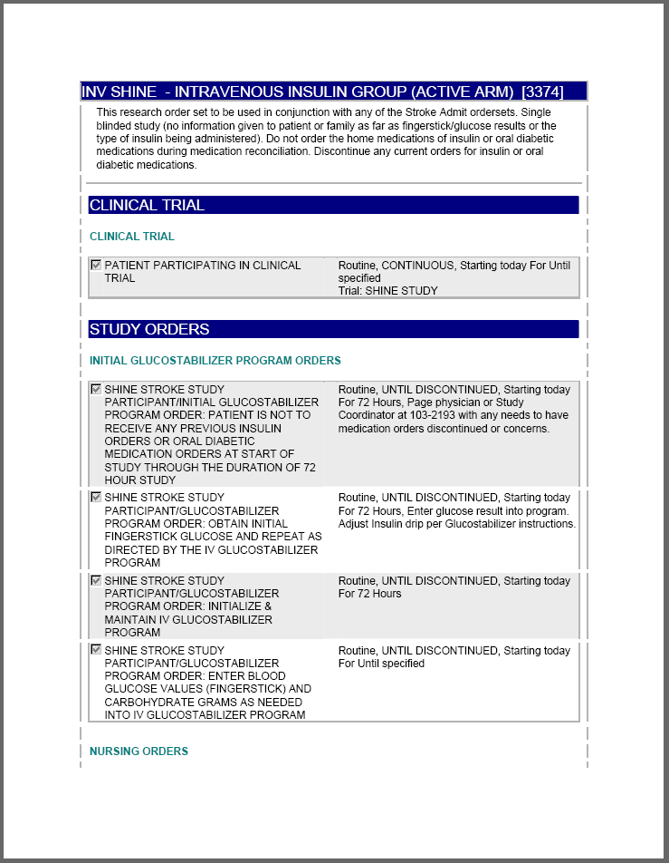
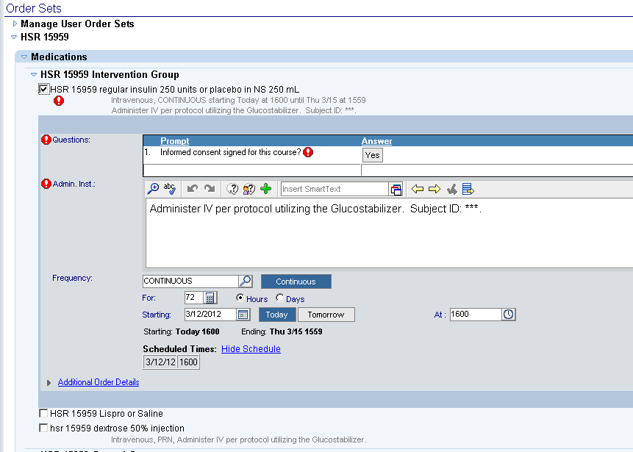

Slide 7
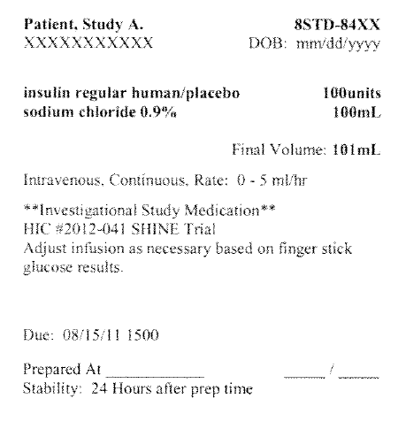
Labels and Naming
Infusion label must not be unblinding

Slide 8
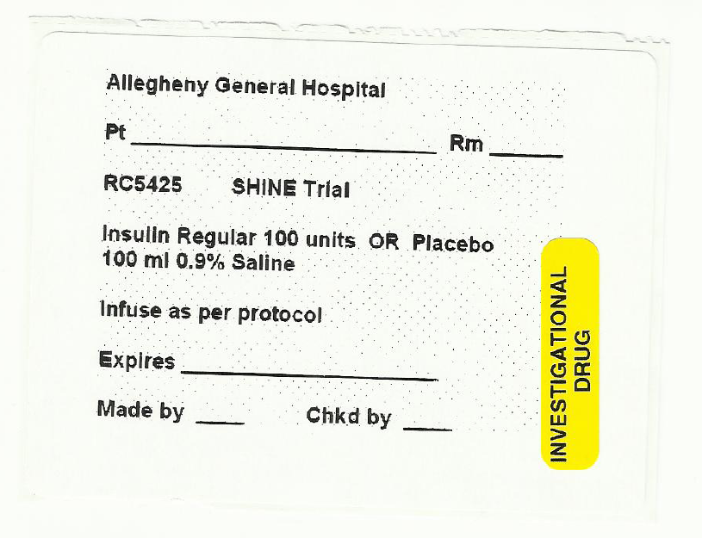
Labels
Standard stickers can be applied (i.e. high risk or inv drug), but must include a matching ‘PLACEBO’ sticker required if ‘INSULIN’ sticker applied

Slide 9
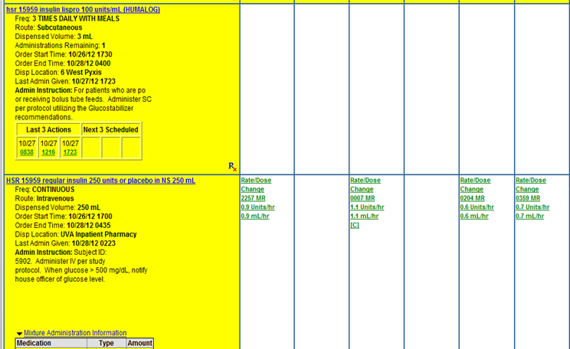
Medical Record & Source Documentation

Slide 10
SHINE Study Drug Stickers
Must only be applied by pharmacist preparing study infusion
Retain the sticker from one infusion bag for monitoring
Study-supplied stickers for infusion (request resupply at least 2 wks in advance)

Slide 11
Anticipating Pharmacy Related Issues
Required labeling due to high risk med
Site-specific standard care preference for insulin pens/training for syringes
Standard care protocols for dextrose-containing solutions

Slide 12
Study Laptops

Slide 13
Preparing Study Laptops
Review by IT or clinical engineering if needed
Confirm preferred connection with IT and set as default
Test laptops
Consider storage location

