Slide 1
CLINICAL TRIAL METHODOLOGY COURSE 2017 WEBINAR SERIES

Slide 2
To view and hear the content please join on a computer or device with speakers. Use the Chat Box to enter questions for the speaker. Instructions for how to obtain CMEs will be provided at the end of the webinar.

Slide 3
AAN CME Disclosure
The presenter has no commercial or financial interests, relationships, activities, or other conflicts of interest to disclose.

Slide 4
Significance/Innovation/Preliminary data/Approach/Rigor/Recruitment feasibility/analyses,
Significance (Scored criterion):
Define the problem and demonstrate impact of solving it.
Common approaches include listing disease incidence, economic costs.
When dealing with a rare disorder explain how knowledge gained could impact more broadly
Define impact on treatment /diagnosis/ prognostication if the project is completed.
Innovation (Scored Criterion):
This can be technological, methodological or conceptual.
Most commonly development or early adoption, or first adoption of novel technology.
Methods: novel trial design, novel outcome measure etc.
Novel hypothesis that challenges existing paradigm

Slide 5
Approach
Preliminary data (Scored under approach):
Opportunity to demonstrate that the applicant/team is capable of performing proposed plan.
Addresses feasibility: recruitment, feasibility of assay, technology, analytics
Unpublished Innovations
Approach (Scored: most common target of criticism; Weaknesses are found here).
How will you accomplish your aims?
Clear, precise delineation of Inclusion criteria, exclusion criteria, subject enrollment mechanism, intervention.

Slide 6
Approach
Primary outcome Must be clearly stated, easy to understand. Provide published or preliminary evidence that it is feasible, reproducible, sensitive and specific measure of the variable of interest (rigor).
Secondary outcomes:Justify each.
Refer to statistical analysis plan (rigor), with justification of expected effect size, and sample size.
Recruitment (common problem) Provide all evidence to support your claim that you can recruit sufficient number of subjects. Be realistic, common error is to be overly optimistic.
Address briefly inclusion of women, children, minorities. Also safety plan. Longer description in human subjects.

Slide 7
Environment & investigator
Environment: Demonstrate that adequate institutional/ network resources exist to support proposed research.
If single institution grant then list department/ school/university resources (equipment /infrastructure/ people).
If through a network then list network resources and individual site resources
Investigator: New Bisoketch form lets you tell your story. List your strengths and weaknesses. Explain how you will address your weakness(es) (usually by using collaborators). List your areas of experitse and publications.
Online tool to create Biosketch: My NCBI » SciENcv

Slide 8
Grant preparation (Admin)
Timing, institutional support, administrative needs.
Multicenter grants require administrative planning, sub contract negotiation, site budgets, support letters. Plan 6-12 months ahead.
Prepare Budget early, revise often as you think of new items. Ask for budgets from other sites early.
Justify each and every item/ person esp if non modular.
If >500 K per year get NIH permission.
Make sure to meet with your Institutional officials to ensure that you have support letters as needed.

Slide 9
Summary statement
Review Group: Example: NSD-K
SRG Action: Impact Score: Range 10-90 or **
Summary of discussion (If scored) This is what was said at the meeting about your application. This discussion determined the final score. Longer when committee is divided.
Individual critiques ( Minimum of 3 ):
Scored criteria
Significance:
Investigator(s):
Innovation:
Approach:
Environment:
Discussed after scores
Protections for Human Subjects, Data and Safety Monitoring Plan , Inclusion of Women, Minorities and Children, Vertebrate Animals, Biohazards, Applications from Foreign Organizations, Select Agents, Resource Sharing Plans. Authentication of Key Biological and/or Chemical Resources. Budget and Period of Support

Slide 10
WRIGHT Qs
What study sections love and hate (Wright)
What happens during the study section (Wright)
What are the review criteria (Wright)
What is an ND?

Slide 11
WHAT STUDY SECTIONS HATE
Sloppiness (grammar, spelling, organization)- ALL sections
Too dense, play on font size and space, small images
Overly ambitions (especially for Jr, or training grants)
Dependent Aims!
Lack of serious statistical support
Poor justification for your approach (populations, testing instruments, outcome measures, alternative hypotheses)
Outrageous budgets
Lack of attention to human subjects

Slide 12
WHAT STUDY SECTIONS LOVE
Clean, supported story
Solid connection from significance, foundation (prelim data), approach, outcomes, interpretation of results
Thoughtful discussion of limitation and how the outcome of the grant will guide discovery even if negative
Evidence that you can do the study - recruitment (type and number), expertise in group, ...especially showing have done before.
Clear path for next step especially if Go-No-Go grant
Lack of serious statistical support
Strong statistical plan

Slide 13
WHAT HAPPENS IN STUDY SECTION

Slide 14
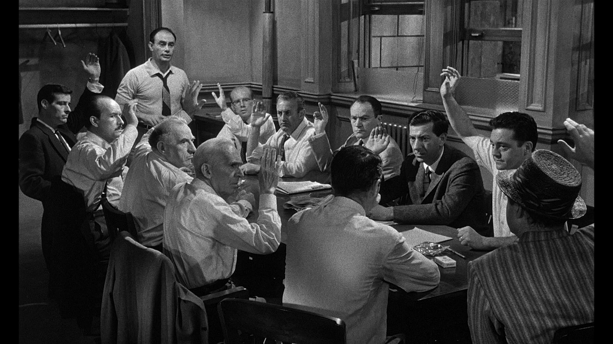

Slide 15
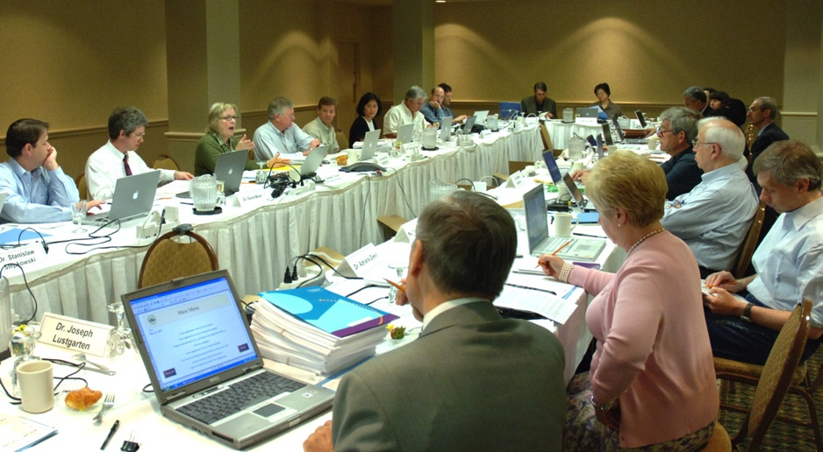

Slide 16
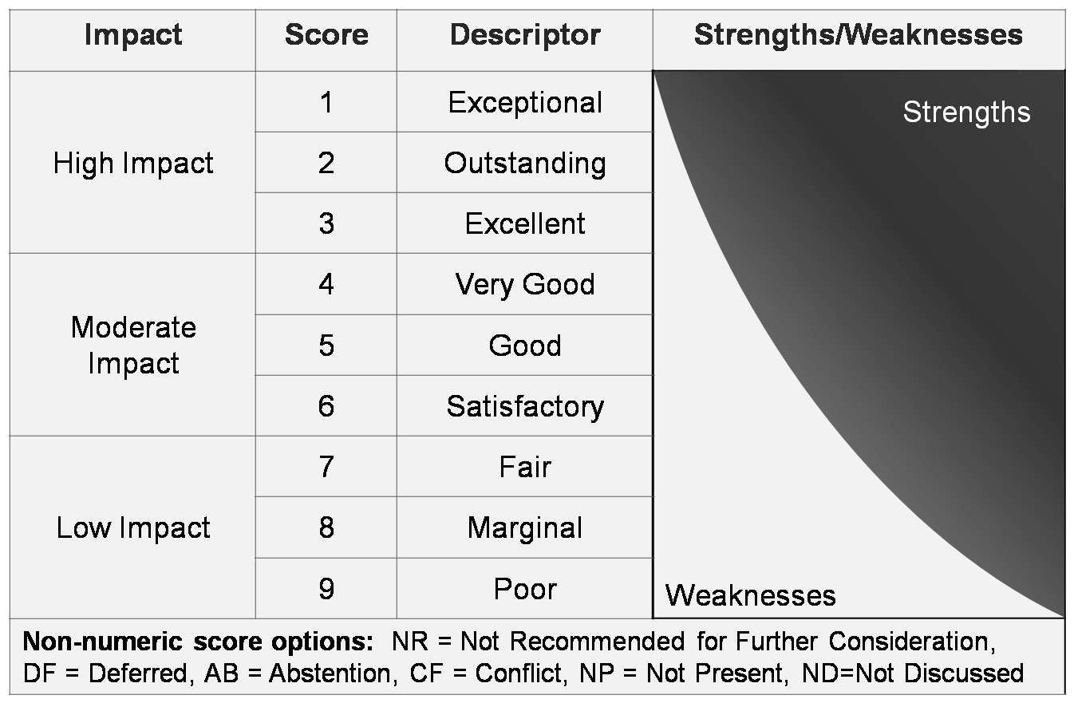
Scoring Descriptions
Notes:
16

Slide 17
Score | Descriptor | Additional Guidance on Strengths/Weaknesses
1 | Exceptional | Exceptionally strong with essentially no weaknesses
2 | Outstanding | Extremely strong with negligible weaknesses
3 | Excellent | Very strong with only some minor weaknesses
4 | Very Good | Strong but with numerous minor weaknesses
5 | Good | Strong but with at least one moderate weakness
6 | Satisfactory | Some strengths but also some moderate weaknesses
7 | Fair | Some strengths but with at least one major weakness
8 | Marginal | A few strengths and a few major weaknesses
9 | Poor | Very few strengths and numerous major weaknesses
Minor Weakness: An easily addressable weakness that does not substantially lessen impact
Moderate Weakness: A weakness that lessens impact
Major Weakness: A weakness that severely limits impact

Slide 18
What Happens in Study Section
Initial scores
Primary Reviewer 1
Provides and overview of your proposal
Scientific foundation reviewer
Presents the preclinical supporting data
Assigned Reviewers 2-(10)
Each get their shot at what’s wrong with the grant
Floor opens to other non-assigned reviewers
Questions back and forth to assigned reviewers
Final points by assigned reviewers
Final scores (tightening of the range sought)
Budget

Slide 19
Notes:
Evaluation Criteria in Grant

Slide 20
Review Criteria
Each scored 1-9
Overall IMPACT (Total Score – not average)
Significance – (incremental advance vs change the field)
Investigators – (experience, experts, stats)
Innovation – (Too little, too much)
Approach – (90% of the review)
Environment – (mostly covered if at academic facility)
Human Subjects (target diversity and genders)
Other (training grant etc)
Budget
Overall Impact Score 1-9 x 10 = final score (e.g. 30); Final Percentile Rank – how many grants scored better than yours (e.g. 50%) in the study section – rank of your grant and payline based on percentile, not your grant score

Slide 21
OMG – NOT DISCUSSED (ND)
MY PROPOSAL WAS NOT SCORED!!!!
Does not mean the idea is doomed
Proposals had enough flaws to push score into non-competitive
Read reviews carefully and respond to EVERY comment
Notes:
Category for doomed – Not Recommended for Further consideration (NRFC)
Understanding the Percentile
A percentile is the approximate percentage of applications that received a better overall impact/priority score from the study section during the past year.
For applications reviewed in ad hoc study sections, a different base may be used to calculate percentiles.
All percentiles are reported as whole numbers
Only a subset of all applications receive percentiles. The types of applications that are percentiled vary across different NIH Institutes and Centers.
The summary statement will identify the base that was used to determine the percentile.

Slide 22
ITS OK, YOU CAN RE-APPLY

Slide 23
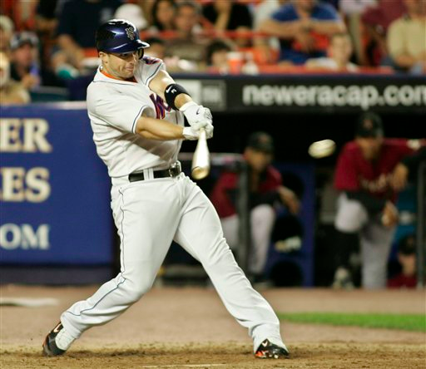

Slide 24
YEAR | AB | H | HR | RBI | BB | AVG
2004 | 263 | 77 | 17 | 40 | 14 | 0.293
2005 | 575 | 176 | 42 | 102 | 72 | 0.306
2006 | 582 | 181 | 40 | 116 | 66 | 0.311
2007 | 604 | 196 | 42 | 107 | 94 | 0.325
2008 | 626 | 189 | 42 | 124 | 94 | 0.302
2009 | 535 | 164 | 39 | 72 | 74 | 0.307
2010 | 587 | 166 | 36 | 103 | 69 | 0.283
2011 | 389 | 99 | 23 | 61 | 52 | 0.254
2012 | 581 | 178 | 41 | 93 | 81 | 0.306
2013 | 430 | 132 | 23 | 58 | 55 | 0.307
2014 | 535 | 144 | 30 | 63 | 42 | 0.269
2015 | 152 | 44 | 7 | 17 | 22 | 0.289
2016 | 29 | 8 | 3 | 0 | 8 | 0.276

Slide 25
Evaluation form for CMEs bit.ly/r25eval
Email ninds-ctmc-info@umich.edu with questions CTMC webinars and slides will be
archived on the course website https://nett.umich.edu/training/ctmc

