Slide 1
Stroke Hyperglycemia Insulin Network Effort (SHINE) Trial
Treatment Protocols
Askiel Bruno, MD, MS
Protocol PI

Slide 2
Agenda
General protocol for control group/ intervention group
Discussion of meals
Hypoglycemia protocol
Pauses of study protocol

Slide 3
SHINE Synopsis
Acute ischemic stroke <12 hrs of symptom onset and within <3 hrs arrival
Baseline blood glucose
>110 mg/dL if known type 2 diabetes
≥ 150 mg/dL if not a known diabetes
Baseline NIHSS 3-22
Randomized, initially single blind – final outcome double blind
Control group: IV saline and SQ insulin (80-179 mg/dL)
Intervention group: IV insulin drip and SQ insulin or saline (80-130 mg/dL)
Final outcome - 3 month mRS

Slide 4
Treatment Groups - General Concepts
Two groups: both glucose control, both insulin
All patients get IV drip & SQ injections
Frequent glucose checks
60 gram carbohydrate diet
Document in medical record and study laptop
NIHSS & AE assessments q 24 hrs
72 hr treatment (starts at time of randomization)
Early d/c per clinical team OK

Slide 5
Control Group

Slide 6
Control Group- General Concepts
BG target: 80-179 mg/dL
Glucose checks: q1-q3 hours (+/- 15 min)
Drip: IV saline drip – 0, 4 or 5 cc/hr
SQ injections: SQ insulin (human regular per sliding scale) and basal insulin (only at 48 hrs if indicated)

Slide 7
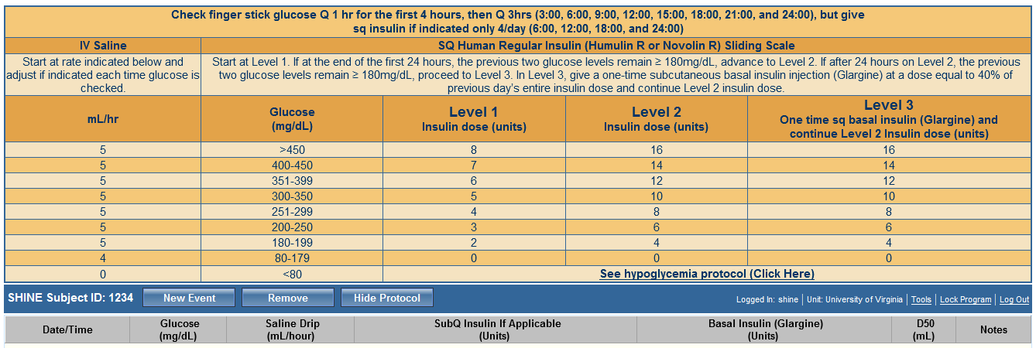
Control Treatment Screen
2
1
3

Slide 8
Control Group- Initiating Treatment
Capillary BG (FSBG)
Check at enrolling hospital ASAP
Re-check post randomization when study treatments are ready and initiate based on this glucose level
Start IV saline infusion per control treatment screen
Only give SQ insulin at designated dosing times

Slide 9
Control Group- Continuing Treatment
Glucose checks q1 hr for 1st 4 hrs then q3 hr sched
If hourly check is within 30 mins of next dosing time, give dose
If 4th hourly check within 1 hr of non-dosing scheduled check, skip
If 4th hourly check is within 1 hr of next scheduled dose, give dose
Call PI on call with these transitions!!!!
Adjust IV saline if needed with each glucose check
Though checking q3 hrs, dosing is q6 hrs as below:

Slide 10
Control Group – Level Changes
Level changes allow increase in insulin coverage for subjects who need higher dosing
All patients on Level 1 for first 24 hrs
Level changes assessed every 24 hrs
Level 2
Advance to Level 2 at 24 hrs if latest two glucose results are > 180mg/dL
Also, possible to advance to level 2 at 48 hrs

Slide 11
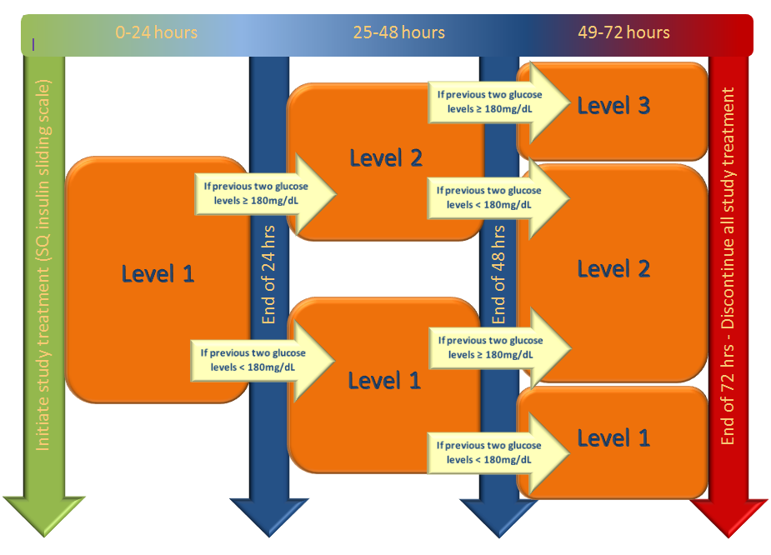
Sliding Scale - Level Changes

Slide 12
Control Group – Level 2

Slide 13
Control Group - Level 3
Advance to Level 3 at 48 hrs if latest two glucose results are > 180mg/dL
Level 3 includes a one-time dose of basal insulin SQ (glargine/Lantus) at 48 hrs
Calculating basal insulin dose
Add all insulin requirement in previous 24 hrs (all 4 doses)
40% of that total is the dose of basal insulin
Basal insulin given SQ now (at 48 hrs)
Continue SQ sliding scale insulin- Level 3

Slide 14
Control Group – Level 3

Slide 15
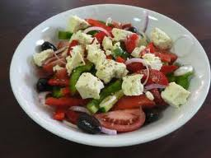
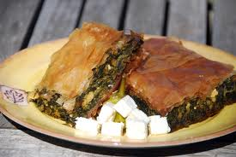
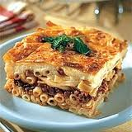
When subjects resume eating

Slide 16
Control Group - Meals
NPO until cleared to swallow
60 grams carbohydrates per meal when start meals
Dysphagia diet/bolus tube feeds must also be 60 grams carbohydrate
Protocol-approved snacks between meals available upon request

Slide 17
Protocol approved snacks
Up to 2 between meals
Unlimited
5 celery sticks + Tablespoon peanut butter
5 baby carrots
5 cherry tomatoes + 1 Tablespoon ranch
1 hard-boiled egg
½ cup raw broccoli + 1 Tablespoon ranch
1 cup cucumber slices + 1 Tablespoon ranch dressing
¼ cup of fresh blueberries
1 cup of salad greens, 1/2 cup of diced cucumber, and with vinegar and oil
2 saltine crackers
1 piece of string cheese stick
½ cup of egg salad, tuna salad or chicken salad
3 oz of deli ham, chicken or turkey slices
1 serving of cubed or sliced cheese (1 oz)
½ cup cottage cheese
½ cup tofu
1 slice deli ham, chicken or turkey + 1 slice cheese
Bouillon and broth
Club soda, unsweetened
Diet soft drinks
Flavoring extracts
Horseradish
Mineral water
Mustard
Pickles
Soy sauce
Spices
Sugar-free drink mixes
Sugar-free gum
Sugar-free Jell-O
Tabasco or hot sauce
Unsweetened lemon or lime juice
Unsweetened tea
Vinegar

Slide 18
Considering timing of meals/checks
Note: The glucose check precedes the meal
6 AM check should precede breakfast (any time from 6AM to 9AM)
Noon check should precede lunch
6PM check should precede dinner

Slide 19
Questions on Control Protocol?

Slide 20
Intervention Group

Slide 21
Intervention Group- General Concepts
BG target: 80-130 mg/dL
Glucose checks: Timing -q1-q2 hrs recommended by GlucoStabilizer® (+/- 15 min)
Drip: IV insulin per GlucoStabilizer®
SQ injections: SQ meal insulin (or saline if NPO)

Slide 22
Intervention Group – Initiating Treatment
Capillary BG (FSBG)
Check at enrolling hospital ASAP
Re-check post randomization when study treatments are ready and initiate based on this glucose level
Start IV insulin infusion per GlucoStabilizer® recommendation

Slide 23
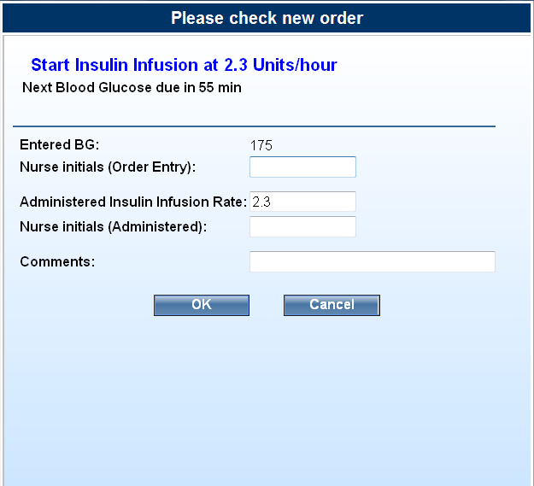
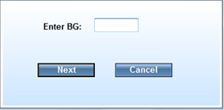
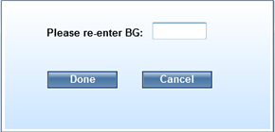
Entry in GlucoStabilizer®
As per previous lap top training…

Slide 24
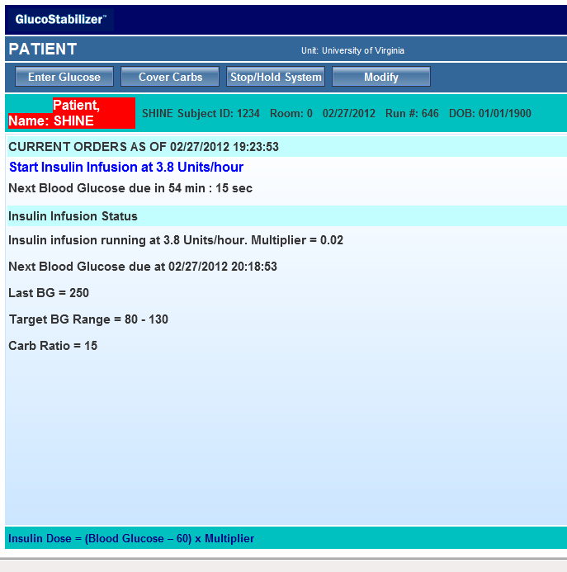
Entry in GlucoStabilizer ®

Slide 25
Intervention Group– Continuing Treatment
Usually q1 hr checks for first 6-8 hrs
May change to q2 hrs if BG stabilized
Dose IV insulin per GlucoStabilizer® each time
SQ injections in intervention group
meal insulin SQ if receiving meals
OR
saline SQ if not receiving meals (09:00 and 21:00)

Slide 26
Intervention Group – Meals PO or bolus tube feeds
NPO until cleared to swallow
60 grams carbohydrates per meal when start meals
Dysphagia diet/bolus tube feeds must also be 60 grams carbohydrate
Protocol-approved snacks between meals upon request
SQ meal insulin (rapid acting analog) based on meal consumption

Slide 27
Intervention Group Estimating Meal Consumption
Nurse assesses meal tray ~20 minutes after start of meal
Estimating PO meal consumption
All or nearly all→ Enter 60
None or nearly none→ No entry in GlucoStabilizer®
Partial→ Enter 30
Do NOT enter any numbers other than 30 or 60 or will get wrong dose
Dose immediately based on computer rec

Slide 28
Intervention Group Estimating Bolus Tube Feeds
Nurse assesses bolus tube feed ~20 minutes after start
Estimating bolus tube feeds
All or nearly all (50-60 grams)→ Enter 60
None or nearly none (0-9 grams)→ No entry in GlucoStabilizer®
Partial (10-49) grams→ Enter 30
Do NOT enter any numbers other than 30 or 60 or will get wrong dose
Dose immediately based on computer recommendation

Slide 29
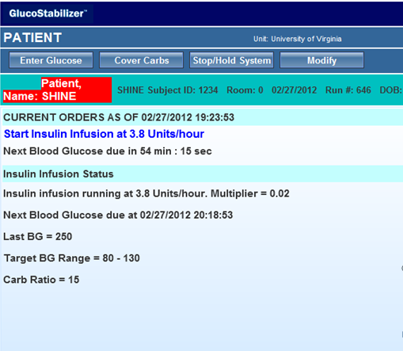
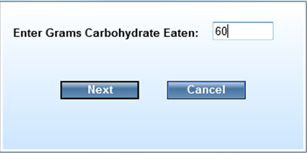
Intervention group Entering Meals in GlucoStabilizer®

Slide 30
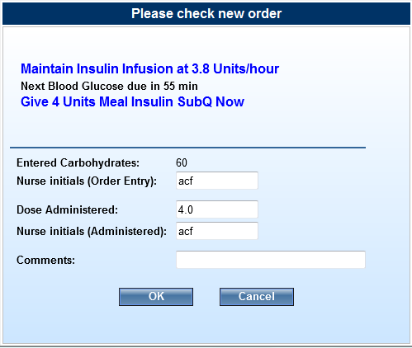
Meal Insulin Dosing
Note: NO entry and NO meal insulin if meal not consumed,
2 unit of insulin if 30 entered, and 4 units of insulin if 60 entered.

Slide 31
Intervention Group NPO or Continuous Tube Feeds
Continuous tube feeds – ~180 total grams carbohydrates daily
SQ injections for NPO or continuous tube feeds
0.05mL Normal Saline (in insulin syringe)
Give right after glucose checks at 09:00 and 21:00
Document in medical record; no entry in GlucoStabilizer®

Slide 32
Questions on Intervention Protocol?

Slide 33
Hypoglycemia Protocols

Slide 34
Hypoglycemia Prevention & Management
Hypoglycemia prevention protocol initiated when BG<80 mg/dL
Definitions
Any hypoglycemia is BG <70 mg/dL (AE)
Severe hypoglycemia is BG <40 mg/dL (SAE)

Slide 35
Hypoglycemia Prevention & Management General Concepts
STOP all SQ and IV study treatments if <80 mg/dL
Give D50 slow IV push (per protocol for each group)
Recheck glucose q 15 minutes
Follow neuro exam and symptoms if <70 mg/dL
Send for serum glucose if <70 mg/dL
Once BG ≥80 mg/dL resume treatment protocols
≥3 BG of <70 mg/dL within 24 hours – required call to independent safety monitor

Slide 36
Hypoglycemia- Special Situations
Intervention group – if <80 at any time during meal, don’t give meal insulin
Control group – if 3 episodes of hypoglycemia within 24 hours don’t advance to level 2 or level 3 even if last 2 checks >=180 (unless instructed by safety monitor)

Slide 37
Hypoglycemia Prevention & Management Glucose <70 mg/dL – Additional Steps
Send a STAT laboratory serum glucose
Hypoglycemia Symptomatic Questionnaire (q15 min)
Once BG ≥ 70mg/dL or symptoms resolve, whichever comes first, one final assessment required
Neuro checks (q15 min) when <70mg/dL
Once BG ≥80 mg/dL, resume treatment protocol

Slide 38
Demonstration of Hypoglycemia Prevention & Management Protocols

Slide 39
Questions on Hypoglycemia Protocols?

Slide 40
Pausing the Treatment Protocol

Slide 41
Pauses – Both Groups
Pausing protocols allow nurses to turn off study treatment for short periods when interruptions are required.
Both groups should stop IV drip and SQ study treatments

Slide 42
Pauses – Control Group
Stop drip and document in study laptop and medical record
Upon return to the unit, restart study protocol based on whether glucose check has been missed:
No missed check
Resume drip
Check glucose at next scheduled time/ dose as appropriate
If a schedule check was MISSED during a pause
Check BG immediately, resume drip per protocol
If insulin dose missed, give injection now based on current glucose level
If next insulin dose is scheduled < 3 hours from a make up dose, skip the next dose
Return to scheduled glucose checks

Slide 43
Pauses - Intervention Group
Stop drip
Document in study laptop and medical record
Select Stop/Hold in GlucoStabilizer®.
Chart the rate change in the med record (rate = 0).
Upon return to the unit, check BG immediately.
If <3 hours since stop drip, Select ‘Resume drip’ (most recent drip run)
If ≥ 3 hours, Select Start a new drip

Slide 44
Demonstration of Pauses

Slide 45
Loss of IV access
Replace IV as quickly as possible
Control group
Document drip stopped in medical record and Control Treatment Screen
Continue glucose checks and SQ insulin dosing
Intervention group – call SHINE PI
Document drip stopped in medical record and GlucoStabilizer®
Continue SQ meal insulin or saline dosing per protocol
Document in GlucoStabilizer® by selecting resume, cover carbs, and stop/hold

Slide 46
Questions on Pauses?

Slide 47
Interruption of continuous tube feeds
Protocol in place for safety in intervention group
Control group protocol to maintain blind

Slide 48
Interruptions in continuous tube feeds Intervention group
Stop IV insulin - select stop/hold in GlucoStabilizer®
If tube feeds restarted in <1 hr, select ‘Resume’, check BG and re-start IV insulin (insulin need is the same)
If tube feeds not restarted at 1 hr, check BG, select ‘Start a New Drip’, and start IV insulin per rec (insulin need has changed)
Continue protocol SQ saline if NPO, meal insulin if meals started

Slide 49
Interruptions in continuous tube feeds Control group
Stop IV saline and document in study laptop
If tube feeds restarted in <1 hr, check BG and re-start IV saline
If tube feeds not restarted by next scheduled BG check, check BG and re-start IV saline then
SQ insulin dosing does not change

Slide 51
Stroke Hyperglycemia Insulin Network Effort (SHINE) Trial
Post Protocol and Outcomes
Karen C. Johnston, MD, MSc
Administrative PI

Slide 52
Reasons to Discontinue Treatment Protocol
Common
72 hours complete
Clinical team ready for discharge
Uncommon
Safety monitor requires discontinuations
Stroke mimic
Death

Slide 53
Discontinuing the Treatment Protocol
Stop all study treatment 6 hrs prior to discharge for patients going home
GlucoStabilizer® Drip Weaning Report (24 hr insulin total) available for review (intervention group)
Post-treatment glucose management per clinical team (can’t use study protocol/computer)
Prepare a plan prior to readiness call (e.g. hospital protocol, endocrine consult)
Discuss transition with medical monitor when required stop for safety

Slide 54
Transition to Standard Care
Per ADA guidelines, scheduled subcutaneous insulin that delivers basal, nutritional and correction components as needed
Consider that oral agents are not recommended in hospitalized patients, but may be initiated or resumed in anticipation of discharge per ADA guidelines.
Consider individualized discharge planning per ADA guidelines

Slide 55
Case Report Form
Warning if <3 days (control)
Reason for early d/c treatment
Glucose control treatments (standard care)

Slide 56
Summary - Clinical Outcomes
Primary Study Outcome – 3 month mRS
Primary Safety Outcome – frequency of severe hypoglycemia (<40 mg/dL) in intervention group versus control group
Additional Outcomes
6 week phone call – mRS by phone, SAEs
3 month - BI, NIHSS, QOL

Slide 57
Follow up visits
Outcomes MUST be done by a blinded assessor
6 week visit – by phone (15 mins) +/- 14 days
mRS and SAEs
3 month visit– in person (30-45 mins) +/- 14 days
mRS – primary outcome
Other clinical/functional/QOL outcomes
SAEs

